Slide 1
Extrema – The Old-fashioned Way
Short Topic 9
Presented by Lin McMullin
Mass Insight Fall Conference
November 2020

Slide 2
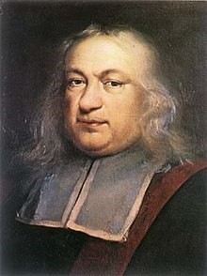
Maximums – The Old-fashioned Way
Here’s how the old guys, Pierre de Fremat specifically, found extreme values without using derivatives or even continuity, which weren’t invented yet.

Slide 3

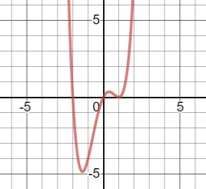
Extremes – The Old-fashioned Way
Consider the function
Notes:
This could be at any extreme. The function in the example has 3 extremes. This technique will find all of them.

Slide 4
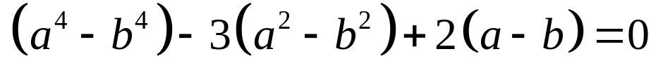
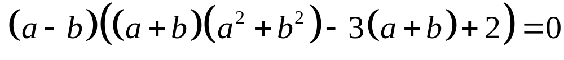
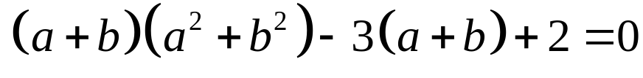
Extremes – The Old-fashioned Way
Near an extreme value, a horizontal line intersects the curve twice, say at x = a and x = b. Since they are on a horizontal line f(a) = f(b)
Notes:
STEP 1
STEP 2: Set = 0 and group by powers
STEP 3: factor
STEP 4: Near the extreme (a – b) is not zero so divided by (a – b)

Slide 5

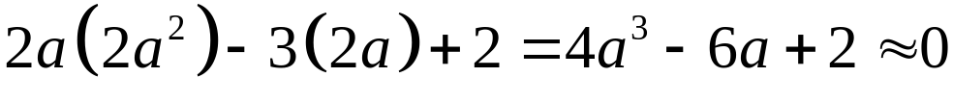
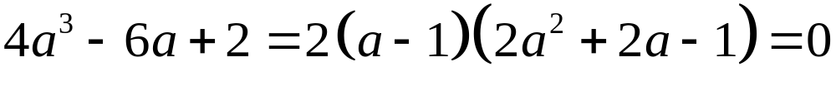
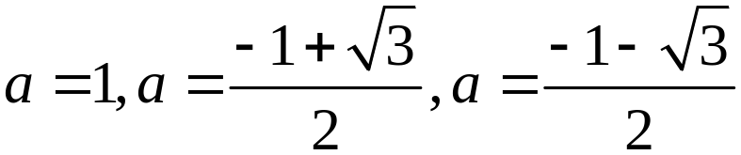
Extremes – The Old-fashioned Way
Near the extreme value , so
These are the coordinates of the critical points!
Notes:
STEP 1: substitute a = b and simplify
STEP 2: Factor by synthetic division
STEP 3: Solve by quadratic formula
GRAPH: Looks about right!

Slide 6

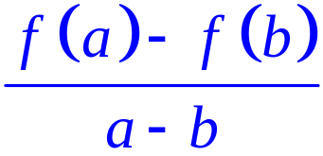
Extremes – The Old-fashioned Way
Since they are on a horizontal line f(a) = f(b)

Slide 7
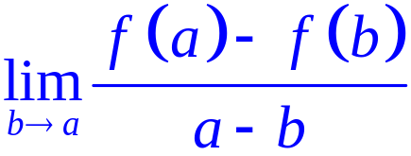
Extremes – The Old-fashioned Way
Near the extreme value , so
These are the coordinates of the critical points!

Slide 8


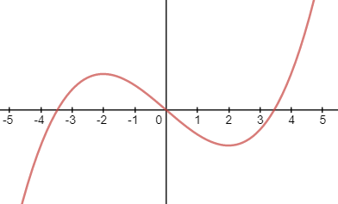

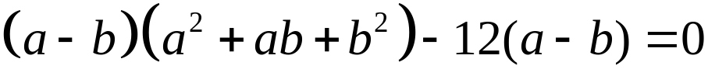




Extremes – The Old-fashioned Way
Now, you try one. Find the extremes of
Notes:
STEP 1: f(a)=f(b)
STEP 2: set = 0
STEP 3: Group and factor (a – b)
SETP 4: Divide by (a – b) NOT = 0
STEP 5: a = b and collect
STEP 6 and 7 Solve
GRAPH not to sacle

Slide 9
Extrema – The Old-fashioned Way
Short Topic 9
Presented by Lin McMullin
Mass Insight Fall Conference
November 2020

Slide 10

Welcome!
Lin McMullin
Moderator, AP Calculus Community
AP Calculus AB & BC teacher for 30 years
AP Consultant since 1991
National Director of Mathematical Programs for the National Math and Science Initiative (2008 – 20012)
Author of Teaching AP Calculus
Blogger at TeachingCalculus.com
Links to resources for this session and a copy of the PowerPoint slides may be found here
www.TeachingCalculus.com > Presentations > Mass Insight
Extremes – the Old-fashioned Way
Notes:
Read last bullet

