Slide 1
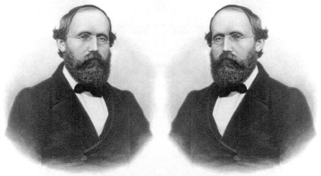
Reversed
Riemann
Short Topic 8
Presented by Lin McMullin
Mass Insight Fall Conference
November 2020

Slide 2
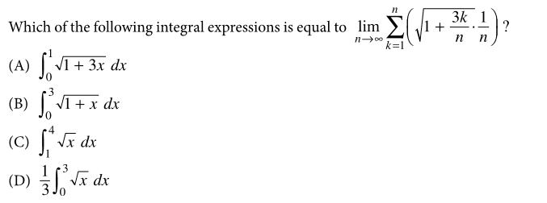
Riemann Reversed
Notes:
2016 CED p. 54
First example from1997 “radical 50” we will see later only 7% of students got it correct. At least they weren’t guessing

Slide 3
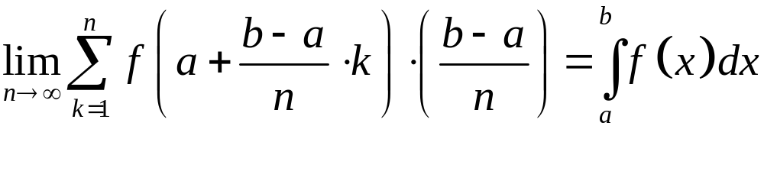


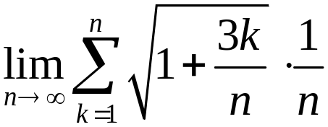
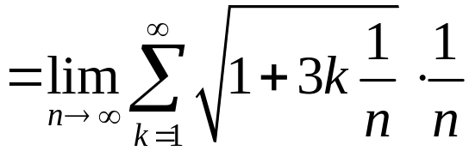
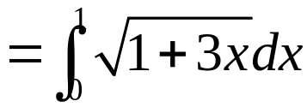
Riemann Reversed
A right-side Riemann sum for the function f on the interval [a, b] with n equal subdivisions, has the form:
Notes:
2016 CED p. 54
Answer Choices: NOTICE Choices B, C, and D can be eliminated once you’ve decided b – a = 1

Slide 4
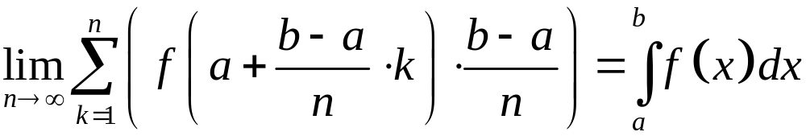


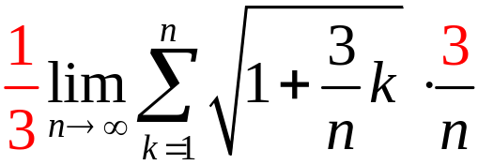
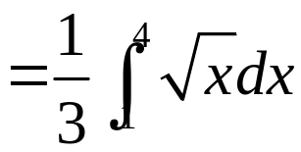
Riemann Reversed
BUT WAIT!
Notes:
2016 CED p. 54

Slide 5
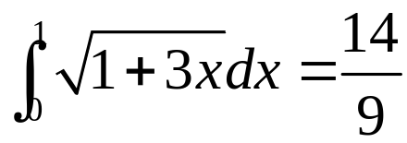
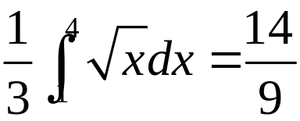

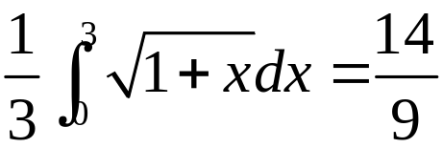
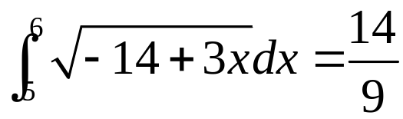
Riemann Reversed
14/9
14/3
14/3
Notes:
PROBLEMS
Answer not unique
When would you do something like this?
Column 1: various correct answers
Column 2: Original choices
Column 3: Original choices as numbers. NOTICE that putting a 1/3 in front of choices B and C gives correct answer.

Slide 6
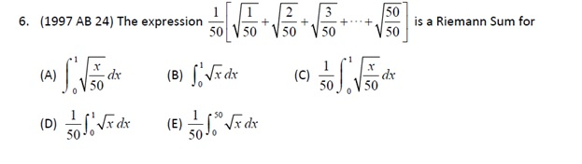
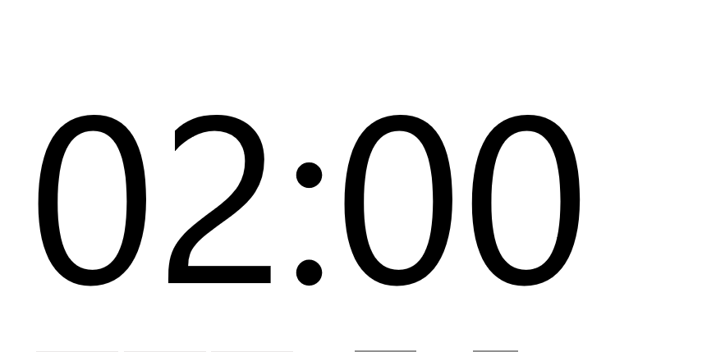
Riemann Reversed
Notes:
Answer B

Slide 7
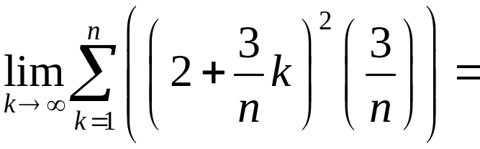
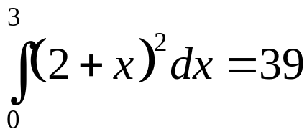
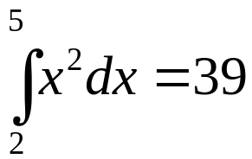
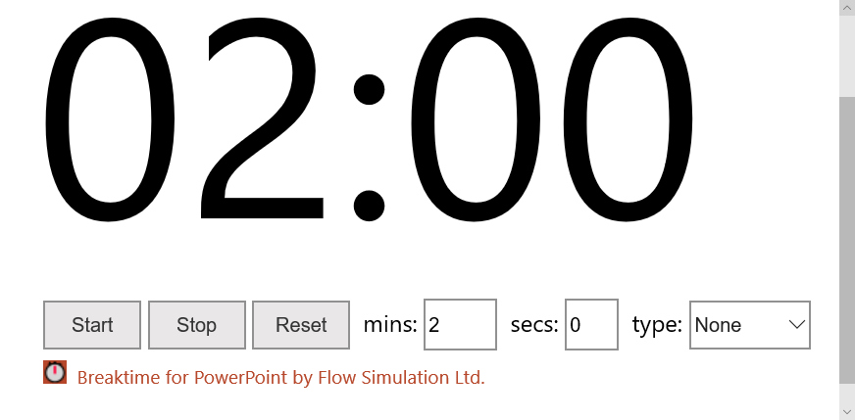
Riemann Reversed
a = 0
a = 2
Notes:
Can you find 2 answers ?

Slide 8
Reversed
Riemann
Short Topic 8
Presented by Lin McMullin
Mass Insight Fall Conference
November 2020

Slide 9

Welcome!
Lin McMullin
Moderator, AP Calculus Community
AP Calculus AB & BC teacher for 30 years
AP Consultant since 1991
National Director of Mathematical Programs for the National Math and Science Initiative (2008 – 20012)
Author of Teaching AP Calculus
Blogger at TeachingCalculus.com
Links to resources for this session and a copy of the PowerPoint slides may be found here
www.TeachingCalculus.com > Presentations > Mass Insight
Riemann Reversed
Notes:
Read last bullet

