Slide 1
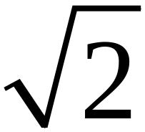
What is ?
Short Topic 4
Presented by Lin McMullin
Mass Insight Fall Conference
November 2020

Slide 2
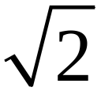
What is ?
The number whose square is 2
Properties
An irrational number
Approximately 1.414
How do you know there is such a number?

Slide 3



What is ?
This number is not rational
It’s not 1 or 2 because
But by the IVT
Can we use this to close in on ?

Slide 4
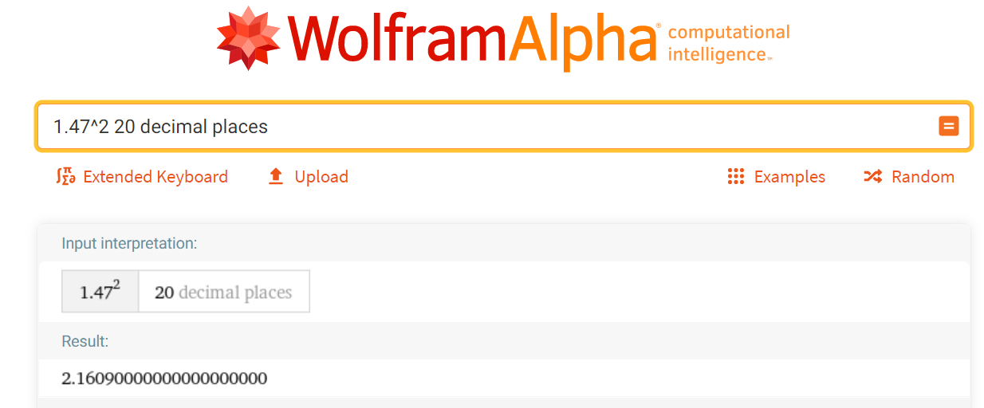

What is ?
Assign everyone or each group a digit 1, 2, 3, 4, … , 9
Append your digit to the last estimate and square it.
Open WolframAlpha (https://www.wolframalpha.com/) and enter your number squared followed by “20 decimal places”
Is your square greater than or less than 2? Repeat!
Notes:
On repeat show how to insert your digit after the current entry without retyping everything.

Slide 5

What is ?
n = decimal places | L_{n} | G_{n}
0 | 1 | 2
1 | 1.4 | 1.5
2 | 1.41 | 1.42
3 | 1.414 | 1.415
4 | 1.4142 | 1.4143
5 | 1.41421 | 1.41422
6 | 1.414213 | 1.414214
7 | 1.4142135 | 1.4142136
8 | 1.41421356 | 1.41423157
9 | 1.414213562 | 1.414213563
10 | 1.4142135623 | 1.4142135624
11 | 1.41421356237 | 1.41421356238
12 | 1.414213562373 | 1.414213562374
13 | 1.4142135623730 | 1.4142135623731
14 | 1.41421356237309 | 1.41421356237310
15 | 1.414213562373095 | 1.414213562373096
16 | 1.4142135623730950 | 1.4142135623730951
17 | 1.41421356237309504 | 1.41421356237309505
Don’t Peak !
Don’t Peak !
Don’t Peak !
Don’t Peak !
Don’t Peak !
Don’t Peak !
Don’t Peak !
Don’t Peak !
Don’t Peak !
Don’t Peak !
Don’t Peak !
Notes:
If you do this in your class don’t quite before row 17 – you’ll see why

Slide 6
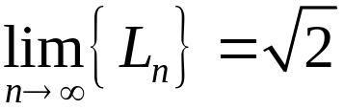
What is ?
n = decimal places | L_{n} | G_{n}
0 | 1 | 2
1 | 1.4 | 1.5
2 | 1.41 | 1.42
3 | 1.414 | 1.415
4 | 1.4142 | 1.4143
5 | 1.41421 | 1.41422
6 | 1.414213 | 1.414214
7 | 1.4142135 | 1.4142136
8 | 1.41421356 | 1.41423157
9 | 1.414213562 | 1.414213563
10 | 1.4142135623 | 1.4142135624
11 | 1.41421356237 | 1.41421356238
12 | 1.414213562373 | 1.414213562374
13 | 1.4142135623730 | 1.4142135623731
14 | 1.41421356237309 | 1.41421356237310
15 | 1.414213562373095 | 1.414213562373096
16 | 1.4142135623730950 | 1.4142135623730951
17 | 1.41421356237309504 | 1.41421356237309505
The two lists, L_{n} and G_{n} , are sequences of real numbers. What are some of their properties?
Increasing? (or decreasing?)
Non-decreasing !
It appears that , but since the sequence never ends, is there a number that it gets closer to?
How do you know?
Notes:
“Get’s closer to” Does it ever get there? STUDENTS ALWAYS WANT TO KNOW!

Slide 7

What is ?
There is a “hole” in the rational number line and L_{n} is approaching this hole from below while G_{n} approaches the same hole from above.
The Axiom of Completeness:
A non-decreasing sequence of real numbers that has an upper bound,
has a least upper bound, and converges to this least upper bound
Our sequence {L_{n}} must have a least upper bound, which we will call
NB: The Axiom of Completeness is also used to prove the Intermediate value Theorem
Notes:
My wording, suitable for high school, if not number theory.
Discuss “upper bound” and “least upper bound (l.u.b.)
As a corollary: A non-increasing sequence of real numbers converges to its greatest lower bound.

Slide 8
What is ? Why do this exercise?
This is what we did:
Produced two sequences that approach - this could be done in 6th – 8th grade when learning about irrational numbers
Learned some WolframAlpha tricks (also suitable for 6th – 8th grade)
Looked at an interesting sequence for BC calculus to introduce sequences and the associated new vocabulary:
  Increasing, decreasing, non-increasing, non-decreasing, upper bound, least upper bound, lower bound, greatest lower bound, converge
Learned a new axiom (Axiom of Completeness)
Give students a real “feeling” for these ideas with a non-trivial example
Notes:
Completeness may be the only axiom introduced in calculus.

Slide 9
What is ?
Short Topic 4
Presented by Lin McMullin
Mass Insight Fall Conference
November 2020

Slide 10

Welcome!
Lin McMullin
Moderator, AP Calculus Community
AP Calculus AB & BC teacher for 30 years
AP Consultant since 1991
National Director of Mathematical Programs for the National Math and Science Initiative (2008 – 20012)
Author of Teaching AP Calculus
Blogger at TeachingCalculus.com
Links to resources for this session and a copy of the PowerPoint slides may be found here
www.TeachingCalculus.com > Presentations > Mass Insight
What is radical 2?
Notes:
Read last bullet

Slide 11
What is ?
Short Topic 4
Presented by Lin McMullin
Mass Insight Fall Conference
November 2020

