Slide 1
Short Topics
Presented by Lin McMullin
Mass Insight Fall Conference
November 2020

Slide 2
Inverses
Short Topic 1
Presented by Lin McMullin
Mass Insight Fall Conference
November 2020

Slide 3




Inverses Review
If , then . If the point (a, b) is on the function, then (b, a) is on its inverse.
Inverses occur in pairs. The inverse of the inverse is the original function.
The inverse undoes whatever the function did and returns the original input value. In symbols this is
The points (a, b) and (b, a) are symmetric to the line y = x and therefore the inverse of a function has a graph that is the reflection of the function’s graph across the line y = x. The function and its inverse are symmetric to this line.
The domain and range switch places: the domain of the inverse is the range of the function and the range of the inverse is the domain of the function.
Notes:
Review things like this when they come up in the curriculum – not in the opening days of school b/c students won’t remember later anyway!

Slide 4
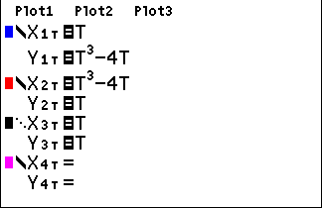
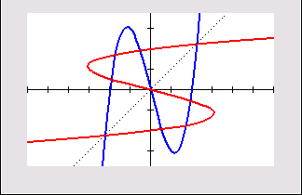
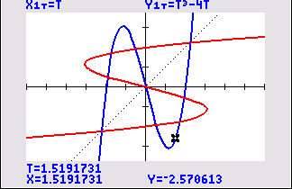
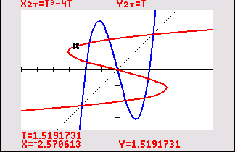
Inverses Review
Graphing Inverses on a Graphing Calculator:
Notes:
Use the definition of inverse to graph inverses in PARAMETRIC mode
Tracing jumps from one graph to the other

Slide 5

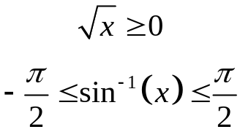
Inverses – Two Problems
1. If , then . There may be no string of operations, no “algebra”, which will produce the output for the inverse function. What do we do in this case?.
Answer: Make up a new function and its notation
The inverse of a function may not be a function. Since there are two numbers whose square is 9, what is the “un-square” of 9; is it 3 or –3? There are many numbers whose sine is ½. To have a unique inverse, a function must be one-to-one. Since it is really useful for the inverse to be a function, what can be done about this?
Answer: Restrict the range
Notes:
Invent a new function and corresponding notation ln(x) or sin⁻¹(x)
Square root , the inverse trig function such as sin⁻¹(x)
Restrictions on the range are arbitrary but standardized and accepted.

Slide 6


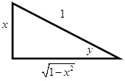
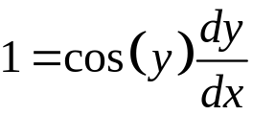
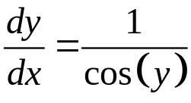
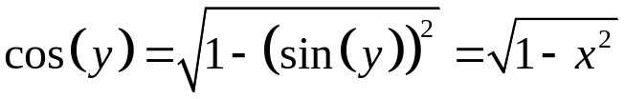
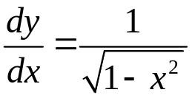

Calculus of Inverses
Differentiate
Rewrite as and use implicit differentiation
The triangle method
Trig Identities

Slide 7
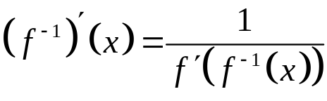
Calculus of Inverses
Theorem: If f is a one-to-one differentiable function, its inverse f ⁻¹ is also differentiable and, provided that the denominator is not 0:
What does that mean? ?
It means, that at the corresponding points, (a, b) and (b, a) the derivatives are reciprocals.

Slide 8
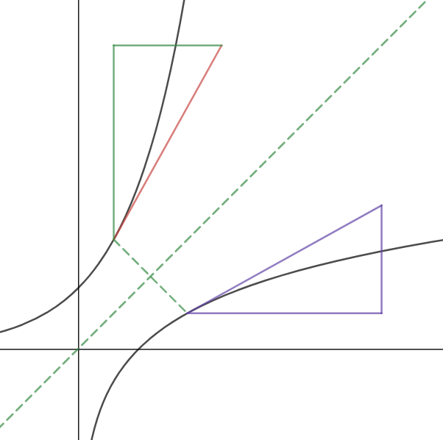
Derivatives of inverses are reciprocals
Go to Desmos Graph

Slide 9
AP Exam Questions on Inverses
2003 AB 27
Let f be the function defined by f(x) = x³ + x. If g(x) = f ⁻¹(x) and
g(2) = 1, what is the value of g'(2)?
(2, 1) is on g(x), so (1, 2) is on f(x).
f '(x) = 3x²+1 and f '(1) = 4
So, g'(2) = ¼ Answer B

Slide 10
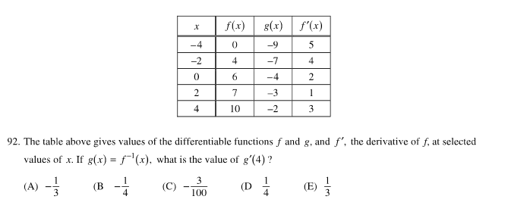
AP Exam Questions on Inverses
2016 AB 92
(4, -2) is on g(x), so (-2, 4) is on f(x).
f ' (-2) = 4, g'(4) = 1/4 Answer D

Slide 11
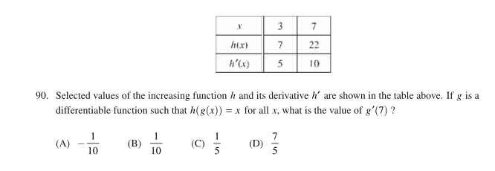
AP Exam Questions on Inverses
2018 AB 90
Since h(g(x)) = x, h and g are inverses
(7, ?) is on g(x), so (?, 7) is on h(x) and ? = 3
h'(3) = 5, g'(7) = 1/5 Answer C

Slide 12
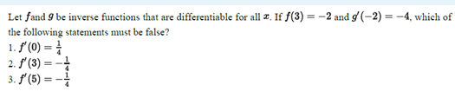
AP Classroom Question on Inverses
(a) 1 only (b) 2 only (c) 3 only (d) 1 and 3 only
Since inverses for all x, f and g are one-to-one:
g’(-2) = - 4 implies f ’(3) = -1/4 implies 2 is true
Both functions are non-increasing, their derivative are non-positive, this implies 1 must be Is false
And 3 may be true

Slide 13
Inverses
Short Topic 1
Presented by Lin McMullin
Mass Insight Fall Conference
November 2020

Slide 14

Welcome!
Lin McMullin
Moderator, AP Calculus Community
AP Calculus AB & BC teacher for 30 years
AP Consultant since 1991
National Director of Mathematical Programs for the National Math and Science Initiative (2008 – 20012)
Author of Teaching AP Calculus
Blogger at TeachingCalculus.com
Links to resources for this session and a copy of the PowerPoint slides may be found here
www.TeachingCalculus.com > Presentations > Mass Insight
Short Talk: Inverses
Notes:
Read last bullet

Slide 15
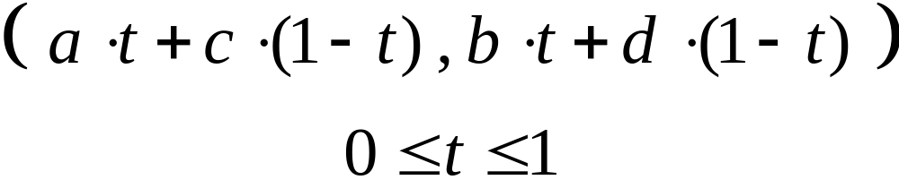
Segments in Desmos
The segment from (a, b) to (c, d) is entered in Desmos as a Bézier curve:

Slide 16
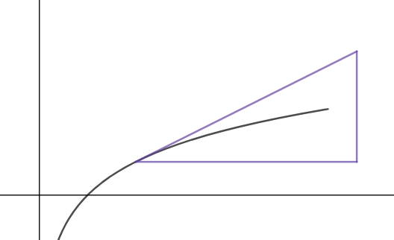






The Slope Triangle

