Slide 1
From the MVT to the FTC
Presented by Lin McMullin
Mass Insight Fall Conference
November 2020

Slide 2

Welcome!
Lin McMullin
Moderator, AP Calculus Community
AP Calculus AB & BC teacher for 30 years
AP Consultant since 1991
National Director of Mathematical Programs for the National Math and Science Initiative (2008 – 20012)
Author of Teaching AP Calculus
Blogger at TeachingCalculus.com
Links to resources for this session and a copy of the PowerPoint slides may be found here
www.TeachingCalculus.com > Presentations > Mass Insight
AP Calculus AB & BC: Reviewing for the Exam

Slide 3
From the MVT to the FTC
Discovering the MVT (Group Exploration)
Demonstrating (Proving) the MVT
Graphical ideas (Desmos)
MVT Examples from AP Exam
Using the MVT to Establish the FTC 1
The FTC 2
FTC Examples from AP Exam
Q & A - Anytime

Slide 4
Discovering the MVT
Enter your favorite function as Y1, and graph in a convenient window
Store values to A and B on the home screen
Find slope from x = A to x = B, store as M
Enter equation of line thru A and B as Y2
Enter equation for vertical distance from function to line as Y3
Find extreme value(s) of Y3
Find the slope (derivative) of Y1 at the extreme(s) you found
Discuss
Notes:
You can do all of this on your graphing calculator without paper and pencil
STEP 1: Enter as Y1
STEP 2: values in your window so that the line from x = A to x = B intersects curve only at endpoints
STEP 3: Find slope of line and store to M
STEP 4: Enter equation of line as Y2
STEP 5: Y3 = function – line. You may want to turn off the first two
STEP 6: Graph derivative and find zeros of Y3
STEP 7: Find slope of Y1 at extreme values and compare
STEP 8: SHOW how to do on screen calculator.

Slide 5
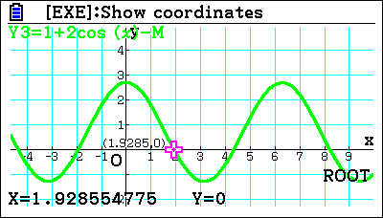
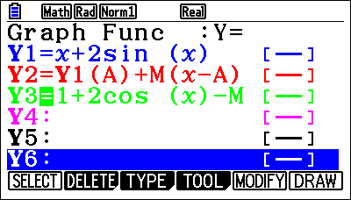
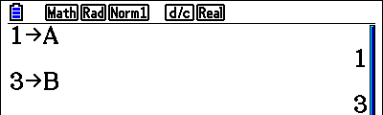
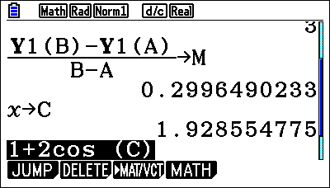
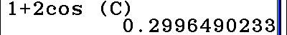
Discovering the MVT
Notes:
You can do all of this on your graphing calculator without paper and pencil
STEP 1: Enter as Y1
STEP 2: values in your window so that the line from x = A to x = B intersects curve only at endpoints
STEP 3: Find slope of line and store to M
STEP 4: Enter equation of line as Y2
STEP 5: Y3 = function – line. You may want to turn off the first two
STEP 6: Graph derivative and find zeros of derivative of Y1 – Y2
STEP 7: Find slope of Y1 at extreme values and compare
STEP 8: SHOW how to do on screen calculator.

Slide 6
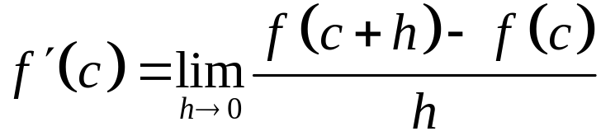



Fermat’s Theorem
If a function f is continuous on a closed interval and has an extreme value (a maximum or minimum) on that interval at x = c,
then the derivative at x = c is either zero or undefined.
Notes:
Since f© is a maximum, f(c) >= f(c+h) regardless of whether h > 0 or h < 0

Slide 7


Rolle’s Theorem
If a function f is continuous on the closed interval [a, b] and differentiable on the open interval (a, b) and if , then there is a number c in (a, b) such that
Notes:
Hint: A function defined on a closed interval, has a maximum and minimum value on the interval
Existence theorem

Slide 8
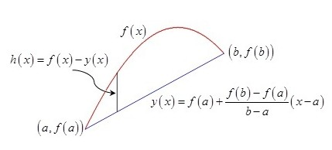

The Mean Value Theorem
$$h\left(x\right)=f\left(x\right)−\left(f\left(a\right)−\frac{f\left(b\right)−f\left(a\right)}{b−a}\left(x−a\right)\right)$$

Slide 9
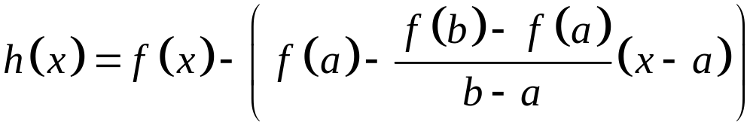


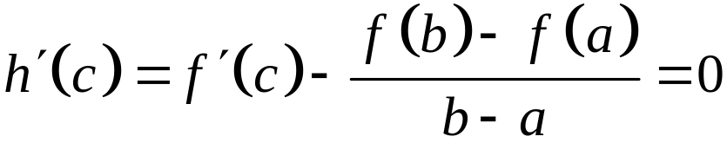
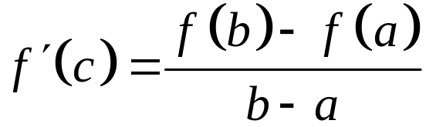

The Mean Value Theorem

Slide 10
The Mean Value Theorem
Desmos Graph
Observation 1: Move the line up and down
Observation 2: There may be more than one value of c
Observation 3: Instantaneous Rate of Change equals Average Rate of change
Observation 4: If you travel a distance at an average rate of 60 mph, then at some point your speedometer must have read 60 mph.
Notes:
ALSO Show Darboux’s Theorem

Slide 11
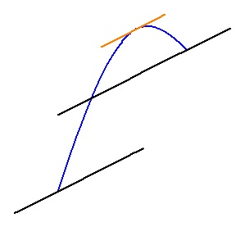
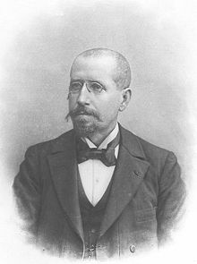
The Mean Value Theorem
Darboux’s Theorem:
If f is differentiable on the closed interval [a, b] and r is any number between f ' (a) and f ' (b),
then there exists a number c in the open interval (a, b) such that f ' (c) = r.
Notes:
The derivative of a curve has the IMV property.
Desmos – turn on k(x) the tangent line
Darboux’s Theorem is a corollary of the MVT, so can’t be used to prove MVT
Requires one-sided derivatives at endpoints – no biggy

Slide 12
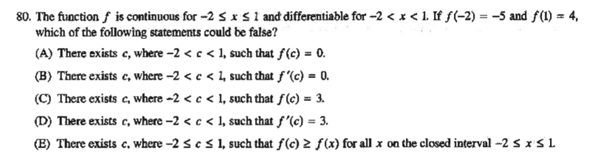
MVT Exam Questions
2003 AB 80
Notes:
2003 AB 80 Answer C
True by IVT
FALSE max and min may be at endpoint; NOT EVT
True by IVT
TRUE MVT
True Extreme value theorem
Note: how they can test all these concepts and theorem in one question.
SUGGESTION: Always discuss wrong answers w/ class

Slide 13
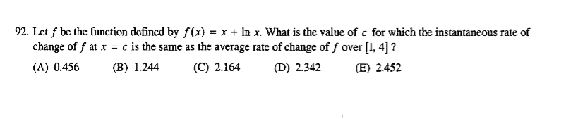
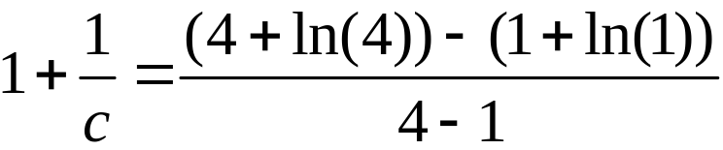
MVT Exam Questions
2003 BC 92
Notes:
2003 BC 92 Answer C 2.1640
SUGGESTION: Always discuss wrong answers w/ class
Forgetting 1 + ln(1) not a choice

Slide 14
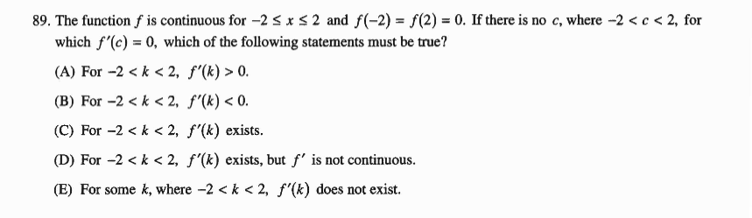
MVT Exam Questions
2008 AB 89 / BC 89
Notes:
2008 AB 89 / BC 89 Answer E
SUGGESTION: Always discuss wrong answers w/ class

Slide 15
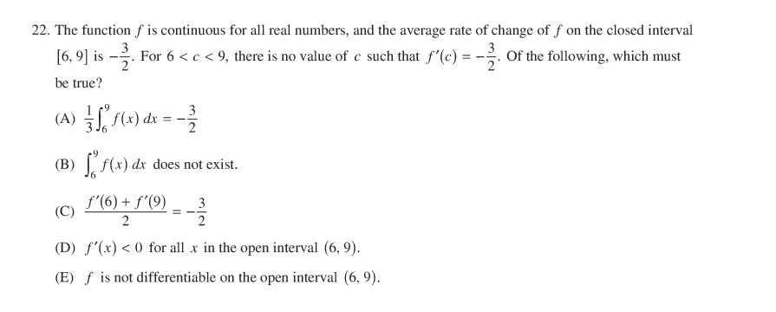
MVT Exam Questions
2013 AB 22
Notes:
2013 AB 22 Answer E
Look for missing hypothesis
Average value not average ROC
Not required
Common mistake w/ average ROC
Not necessary
Correct
SUGGESTION: Always discuss wrong answers w/ class

Slide 16
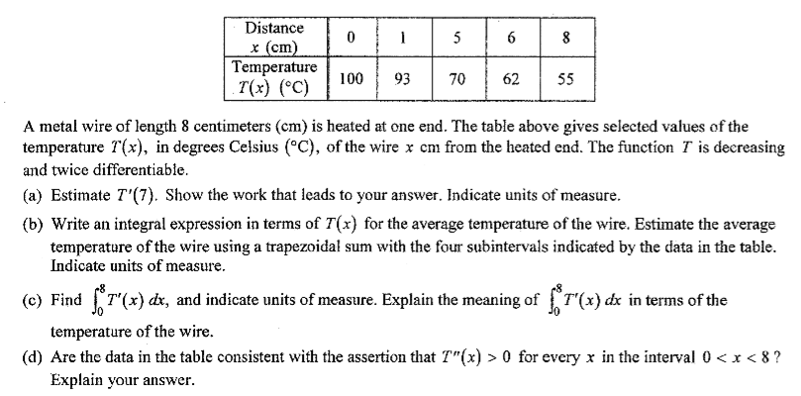
MVT Exam Questions
2005 AB 5 / BC 5
Notes:
We will return to this question for FTC part (c)
Look at (d)

Slide 17
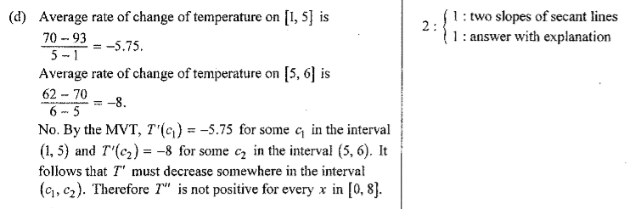
MVT Exam Questions
2005 AB 5 / BC 5

Slide 18
MVT Exam Questions
Discussion, comments, and questions on the MVT
Notes:
pause

Slide 19

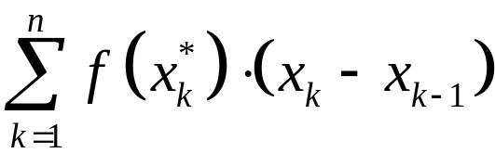
Riemann Sum
Partition of an interval [a, b]
Let
Then the Riemann sum for a function, f, on the interval is
Notes:
Preliminary definitions REVIEW
Partition
Riemann sum

Slide 20
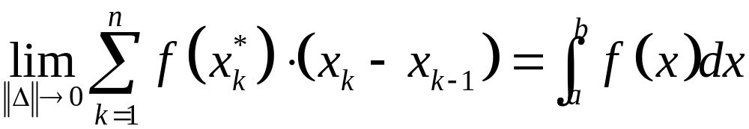
Riemann Sum
The definite integral of f (x) from x = a to x = b is defined as
Notes:
Define “norm of the partition”

Slide 21
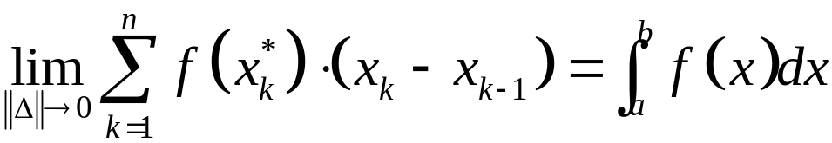
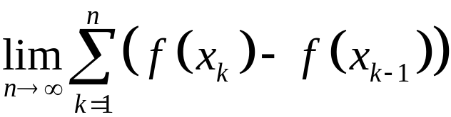
Riemann Sum
The definite integral of f (x) from x = a to x = b is defined as
The net change in f (x) on [a, b] is f (b) – f (a)
The net change is also the sum of the net change on each subinterval defined by the partition:
Notes:
Second form is the sum of the net changes on each subinterval – positive, negative, or zero –
HOWEVER, This last is not a Riemann sum!

Slide 22
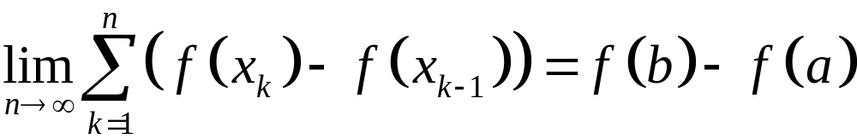

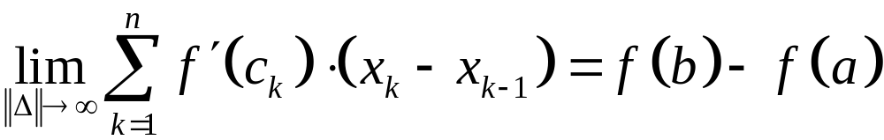
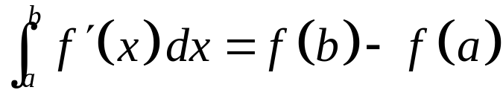
Riemann Sum
The Mean Value Theorem:
Notes:
This last is not a Riemann sum!

Slide 23
Fundamental Theorem of Calculus
Use 1: The integral of a rate of change is the net amount of change.
They ask for an amount, so look around for a rate to integrate!

Slide 24
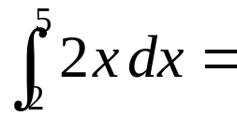
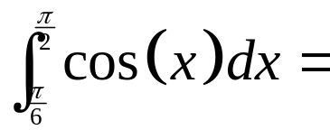
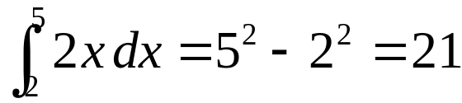
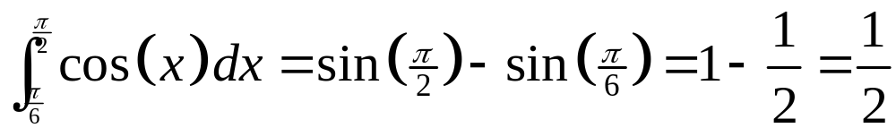
Fundamental Theorem of Calculus
Use 2: Evaluating definite integrals

Slide 25
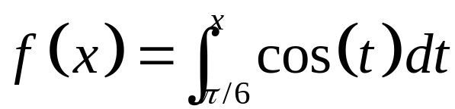
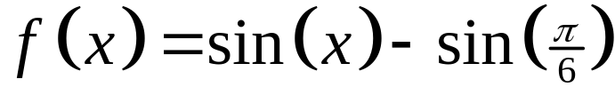
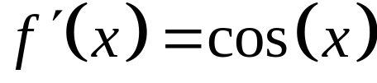
Fundamental Theorem of Calculus - 2
Examples of differentiating functions defined by an integral:

Slide 26
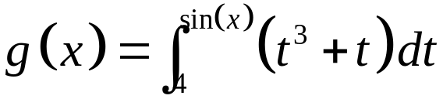
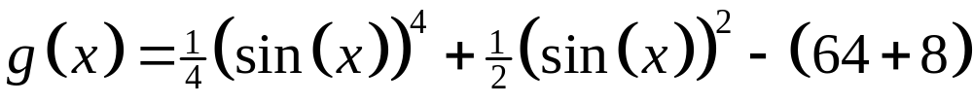
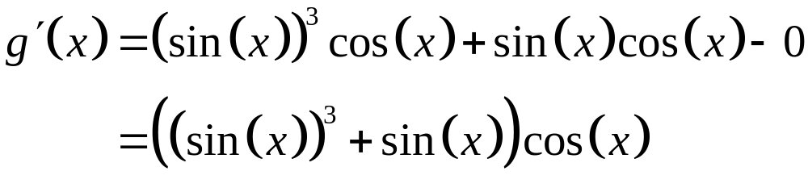
Fundamental Theorem of Calculus - 2
Examples of differentiating functions defined by an integral:

Slide 27
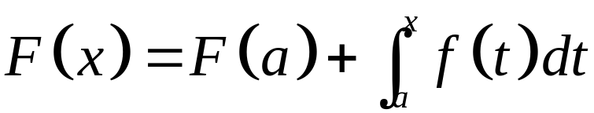
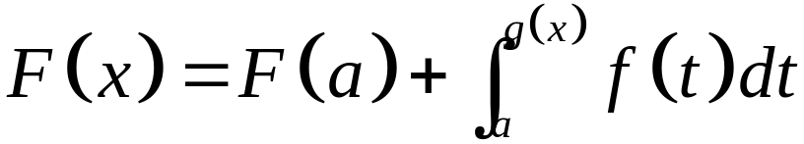
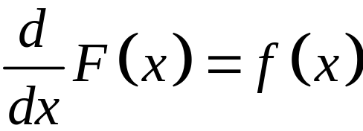
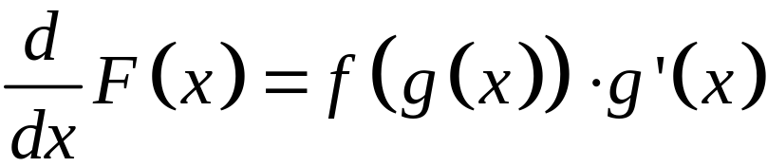
Fundamental Theorem of Calculus - 2

Slide 28
Integration Itineraries
After teaching derivatives you can teach…
Unit 6: Integration up to the FTC (6.1 – 6.7)
Unit 6: Antiderivatives (6.8 – 6.14)
Unit 7: Differential Equations
Unit 8: Integration Applications
Integration up to the FTC
Antiderivatives
Integration Applications
Differential Equations
Antiderivatives
Integration up to the FTC
Integration Applications
Differential Equations
Integration up to the FTC
Integration Applications
Antiderivatives
Differential Equations
Notes:
Trip 1 – AP CED 2019
PRO: Natural Flow
CON: Seems like the wrong place for Diff Eqs
Trip 2
PRO: Most books use this order
PRO: Antiderivatives are ready after you get to FTC
CON: Seems like a game – reverse differentiation
Trip 3
PRO: Natural flow – now you need antiderivatives
CON: slight pause before using integration (applications)
Trip 4
PRO: Do applications w/ calculator without stopping
PRO: No shifting gears to do antiderivatives in every problems, and then returning to application
PRO: Antiderivative are done just before using them in differential equations
PRO: Spiraling applications

Slide 29
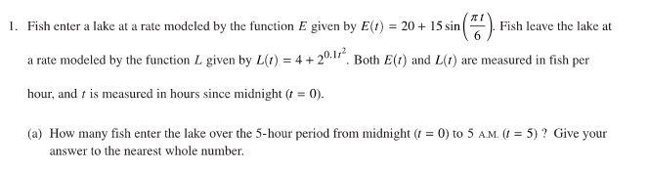
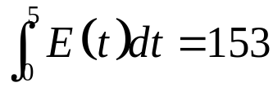

FTC Exam Questions
They ask for an amount, so look around for a rate to integrate!
2019 AB 1
Notes:
“at a rate” and “fish per hour” both indicate the derivative
The mathtype is the minimum acceptable answer – that’s all they need to write.

Slide 30
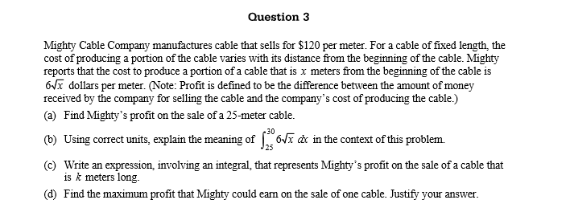

FTC Exam Questions
2009 AB 3 The Mighty Cable Company
Notes:
Mean 1.92; 36.9% zeros; 0.02% nine

Slide 31
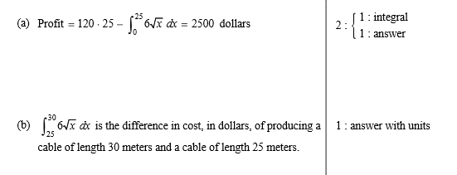
FTC Exam Questions
They ask for an amount, so look around for a rate to integrate!
2009 AB 3 The Mighty Cable Company
Notes:
Mean 1.92; 36.9% zeros; 0.02% nine
(A) Integral is the net cost (amount) of 25 m cable

Slide 32
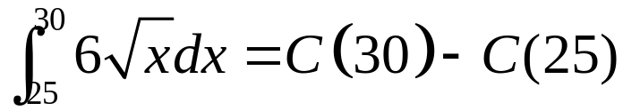
FTC Exam Questions
2009 AB 3 The Mighty Cable Company
Notes:
Mean 1.92; 36.9% zeros; 0.02% nine
6 radical x is the derivative of the cost of producing cable – Dollars per meter
Explain the meaning of a definite integral requires three theing: (1) what it is, (2) the units, and (3) what the numbers, the limits of integration, relateto the context.

Slide 33
FTC Exam Questions
2009 AB 3 The Mighty Cable Company
Notes:
Mean 1.92; 36.9% zeros; 0.02% nine

Slide 34
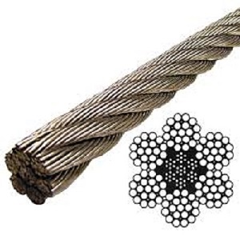
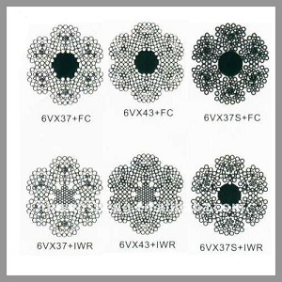
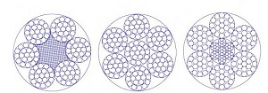
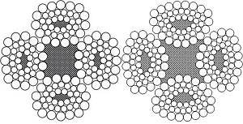
FTC Exam Questions
Wire Rope Geometry
Notes:
Wire Rope Geometry

Slide 35
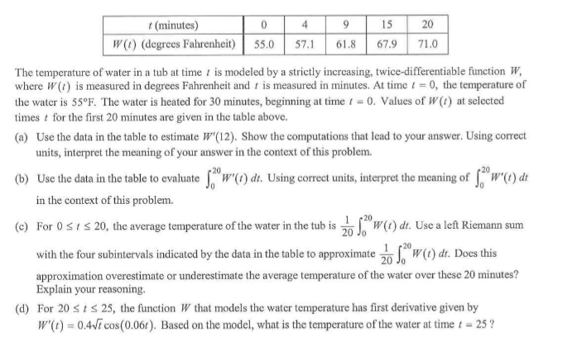
FTC Exam Questions
2012 AB 1 / BC 1

Slide 36


FTC Exam Questions
2012 AB 1 / BC 1

Slide 37

FTC Exam Questions
2006 AB4

Slide 38



FTC Exam Questions
2006 AB4

Slide 39
FTC Exam Questions
2005 AB 5 / BC 5

Slide 40

FTC Exam Questions
2005 AB 5 / BC 5

Slide 41

FTC Exam Questions
2012 BC 28
Notes:
0/0 type using FTC2
Answer (D) 2

Slide 42



FTC Exam Questions
Fake
Notes:
0/0 type
Answer (A) -1

Slide 43
MVT Exam Questions
Discussion, comments, and questions on the FTC
Notes:
pause

Slide 44
From the MVT to the FTC
Presented by Lin McMullin
Mass Insight Fall Conference
November 2020

Slide 45
Welcome!
Lin McMullin
Moderator, AP Calculus Community
AP Calculus AB & BC teacher for 30 years
AP Consultant since 1991
National Director of Mathematical Programs for the National Math and Science Initiative (2008 – 20012)
Author of Teaching AP Calculus
Blogger at TeachingCalculus.com
Links to resources for this session and a copy of the PowerPoint slides may be found here
www.TeachingCalculus.com > Presentations > Mass Insight
AP Calculus AB & BC: Reviewing for the Exam
Notes:
Read last bullet

