Slide 1
Reviewing for the AP Calculus Exams
Writing on the AP Calculus Exams
Presented by Lin McMullin
Mass Insight Fall Conference
November 2020

Slide 2

Welcome!
Lin McMullin
Moderator, AP Calculus Community
AP Calculus AB & BC teacher for 30 years
AP Consultant since 1991
National Director of Mathematical Programs for the National Math and Science Initiative (2008 – 20012)
Author of Teaching AP Calculus
Blogger at TeachingCalculus.com
Links to resources for this session and a copy of the PowerPoint slides may be found here
www.TeachingCalculus.com > Presentations > Mass Insight
AP Calculus AB & BC: Reviewing for the Exam
Notes:
Read last bullet

Slide 3
Agenda
Introduction and Overview
Why Review?
Before you Review
Reviewing Resources, Ideas, and Methods
This year’s exams are on Tuesday May 4, 2021 at 8:00 am Local time
Reviewing: General information students need to know about the exam
Reviewing: The 10 “Type” Questions with examples
The writing questions on the AP Calculus exams
Q&A any time.

Slide 4
Learning Goals
Reviewing is a concern for teachers and students. It is always the subject of many questions at workshops, APSIs, and on the AP Calculus Community Bulletin Boards.
During this online event we will discuss
ways to review; different review approaches
where to find resources for reviewing
timeline and other planning
the 10 type questions that appear on the AP Calculus exams, and what students need to know and be able to do for each

Slide 5
Why Review?
Why review? What is the student’s goal?
To make mistakes!
Students should review to determine what they DON’T know, and (re)learn it. Therefore, the students’ goal is to make mistakes!
Beside the calculus, students also need to know
  the style, format, and timing of the exams.
  how to present their answers clearly and concisely
  what is expected and required to earn credit.
Teachers review so they can
  Help students learn from their mistakes
  Learn what students struggle with, so teachers can work on that next year.
Notes:
Read slide
Therefore, don’t peanalize them when they make a mistake

Slide 6
Before You Review
Teach a good course.
Use actual free-response questions all year long
  Adapt questions
  Work on the fine points.
  See “On Grading” and “On Scaling” at www.TeachingCalculus.com
Use actual multiple-choice questions all year long
  DON’T use Scantron – read the work!
  Require students to show their work and give partial credit
  True – False, and Sometimes – Always – Never with reasons
Homework for teachers: Study past exams.
  learn the types and styles.
  Learn how the topics are tested and how questions are asked.
  See what is expected for an answer (and what is not)
“Cheating” – The “secure” exams are online
Notes:
Teach a good course:
Study past FR and MC exams – topics, style, how to answer
Use FR all year
Adapt questions by using only parts of the question they are ready for; later use other parts and reuse the first ones (spiraling)
Change the point value for fine points.
Discuss missing dx and so on. Make them do it right – don’t accept close even if the readers might.
See On Grading and On Scaling in handout
Use MC All year long
Do NOT use Scantron
Give partial credit - require students to show their work and reasoning. This is so you can see what they are missing – Formative Assessment. 3 points works well.
True – False and S,A,N with reasons/justifications – good for writing practice and thinking.
TEACHER’S HOMEWORK ASSIGNMENT during the year: study past exams,
learn the types and styles.
Learn how the topics are tested and how questions are asked.
See what is expected for and answer (and what is not)
Cheating – secure exams online.
Suggestions
See A Modest Proposal. On blog

Slide 7
On Grading
The AP Calculus scoring standards are considered as a guide for awarding partial credit.
  Partial credit is earned for taking correct steps on the way to the solution.
  Points are earned, not deducted.
  Once earned, points are “in the bank.”
Each part of a FR questions is worth a few point – you may change this for your class to emphasize what need emphasizing.
Multiple-choice – require work/reasons.
True –false, always, sometimes or never questions – require reasons or counterexamples.
Use past AP questions all year long.
Use your textbook questions.
Use the AP Classroom questions.
Make up your own questions.
Notes:
Each step is worth 1 or 2 points. For 2-point steps, it must be possible to earn only one point.
Students earn the point(s) for showing they are doing a good thing.
Once earned, the point cannot be lost by some later mistake. (It’s “in the bank,” as readers say.)
Since a mistake will affect the final answer, the student may earn later points, including the answer point, for continuing correctly. However, some mistakes are so bad that earning the rest of the points is not possible. Mistakes must not simplify the remaining work.
The standard must allow for different methods of solution.

Slide 8
On Scaling
NO ONE can make two of equal difficulty tests on the same material – that’s why scaling is necessary.
College Board spends a great deal of time and money to scale their tests.
Some poor scaling methods:
  Straight percentage – yes, that’s a scaling method
  Throw them up the stairs
  Look for natural breaks between letter grades
  Square root curve
A suggestion – the Kennedy Method
Notes:
Kennedy
Challenge kids – ask difficult questions
No need for exactly 100 points

Slide 9
Reviewing Resources & Ideas
Resources:
  Type Analysis index
  YOUR HOMEWORK ASSIGNMENT
  Commercial review books
  AP Classroom
Ideas
  Calculus Camp
  Saturday review sessions
  Afternoon, evening, or all-day review session
  In class review
  Simulated Exams
  Zoom Review
Notes:
Resources
Ted Gotts FR index Show and discuss
My MC index Show and discuss
Ideas:
Calculus Camp
Saturday review sessions w/ or w/o other schools, as per NMSI
All day review session
Simulated Exams – yes, do at least one so students can get used to timing etc.
Q&A

Slide 10
Timeline
Ideally: 3 school weeks or more if possible. Monday April 12, 2021 or earlier. Don’t forget April vacation!
Go over the exam directions and timing
The before the exam students should
  Relax the day before the exam, take the night off, go to bed early.
  Eat a good breakfast before the exam.
  Bring a snack for the break.
  Install fresh batteries in the calculators and put them in RADIAN mode.
  Get Psyched!
This year’s exams are on
Tuesday May 4, 2021
at 8:00 am local time
Notes:
Exam Dates
Directions and Timing – spend some time going over the FR directions q.v. following

Slide 11
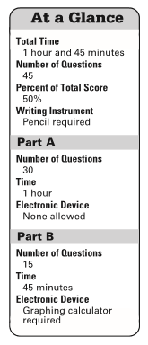
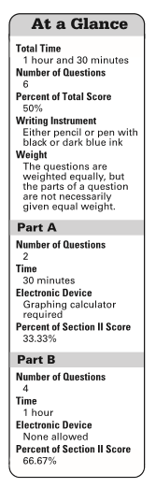
Timeline
Directions:
MC FR
AP Calculus AB & BC: Reviewing for the Exam
This year’s exams are on
Tuesday May 4, 2021
at 8:00 am local time
From the 2019 AP Calculus Exams. Check for changes in 2021.
Notes:
Black pencils for MC
Black pencil, or Blue or Black pens for FR (NO other colors or highlighters)
Time per question MC 2 mins / 3 minutes and FR 15 minutes
Graphing calculator required on 2 sections (May bring 2 if both approved, no scientific calculators)
Timing on FR – in part B they may go back to part A w/o calculators

Slide 12
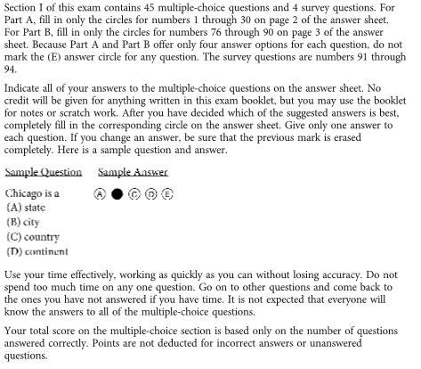
Timeline
Multiple-choice Directions:
AP Calculus AB & BC: Reviewing for the Exam
This year’s exams are on
Tuesday May 4, 2021
at 8:00 am local time
AP Calculus AB & BC: Reviewing for the Exam
This year’s exams are on
Tuesday May 4, 2021
at 8:00 am local time
From the 2019 AP Calculus Exams. Check for changes in 2021.
Notes:
Pencils !!!
On MC – no penalty for wrong answers – Guess, don’t leave blanks

Slide 13
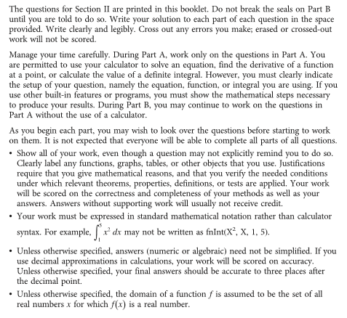
Timeline
Free-response Exam Directions:
AP Calculus AB & BC: Reviewing for the Exam
This year’s exams are on
Tuesday May 4, 2021
at 8:00 am local time
From the 2019 AP Calculus Exams. Check for changes in 2021.
π
3.1415926
3.141
3.142
3.1416
3.1419876543
3.14267895
Notes:
Exam Directions:
X out mistakes – Don’t erase.
Block 1:
Calculator active
what they must be able to do, 4 things
show set-up and answer
In part B you may return to part A w/o calculator
Block 2:
Show all your work
Justifications e.g. L’Hospital’s Rule
Bald answers usually receive NO credit
Block 3: Use standard notation
Block 4:
Simplification NOT required,
don’t do it: you could lose points.
Use decimals only if answer came from calculator
Learn how to save and recall answers on calculator
3-decimal place rule (always give more) Use only if answer comes from calculator
Explain using example pi = 3.1415926
Don’t round, just carry 5 places
Rounding too soon – definite integrals
Learn how to store and recall numbers on calculator

Slide 14
Discussion, Questions, and Comments

Slide 15
The 10 Type Questions
AB and BC Topics
  Type 1 questions – Rate and accumulation questions
  Type 2 questions – Linear motion problems
  Type 3 questions – Function / Graph analysis problems
  Type 4 questions – Area and volume problems
  Type 5 questions – Table and Riemann sum questions
  Type 6 questions – Differential equation questions
  Type 7 questions – Miscellaneous
BC only topics
  Type 8 questions – Parametric and vector questions
  Type 9 questions – Polar equations
  Type 10 question – Sequences and Series
Notes:
This is NOT the same breakdown as will appear on the new CED (May 2019)
Encourage mistakes –
Emphasize the style, format and the ways they ask the same questions – graph stem, table stem, analytic stem – and always read and interpret the words
Explain how to organize the review
2-3 days per topic
One new topic question – go over next day and look at Blog notes
Assign one or two of the same, or one and some MC questions and then one new topic
Repeat
AB and BC Topics
Type 1 questions - Rate and accumulation questions
Type 2 questions - Linear motion problems
Type 3 questions - Graph analysis problems
Type 4 questions - Area and volume problems
Type 5 questions - Table and Riemann sum questions
Type 6 questions - Differential equation questions
Type 7 questions – miscellaneous
BC only topics
Type 8 questions - Parametric and vector questions
Type 9 questions - Polar equations
Type 10 questions - Sequences and Series

Slide 16
The 10 Type Questions
Plan and organize your review using the Ten Topics
2-3 days per topic
One new topic question – go over next day and look at Blog notes
Assign one or two of the same, or one and some MC questions and then one new topic
Repeat
Notes:
This is NOT the same breakdown as will appear on the new CED (May 2019)
Encourage mistakes –
Emphasize the style, format and the ways they ask the same questions – graph stem, table stem, analytic stem – and always read and interpret the words
Explain how to organize the review
2-3 days per topic
One new topic question – go over next day and look at Blog notes
Assign one or two of the same, or one and some MC questions and then one new topic
Repeat
AB and BC Topics
Type 1 questions - Rate and accumulation questions
Type 2 questions - Linear motion problems
Type 3 questions - Graph analysis problems
Type 4 questions - Area and volume problems
Type 5 questions - Table and Riemann sum questions
Type 6 questions - Differential equation questions
Type 7 questions – miscellaneous
BC only topics
Type 8 questions - Parametric and vector questions
Type 9 questions - Polar equations
Type 10 questions - Sequences and Series

Slide 17
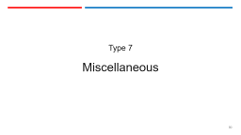
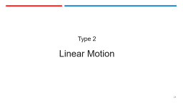
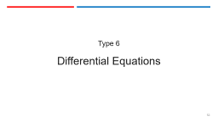
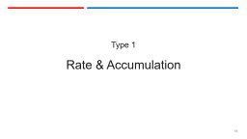
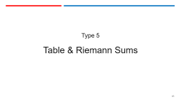
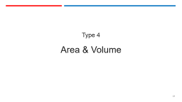
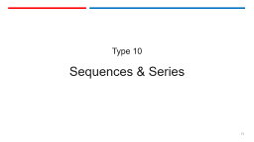
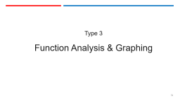
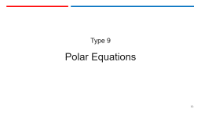

Slide 18
Type 1
Rate & Accumulation

Slide 19
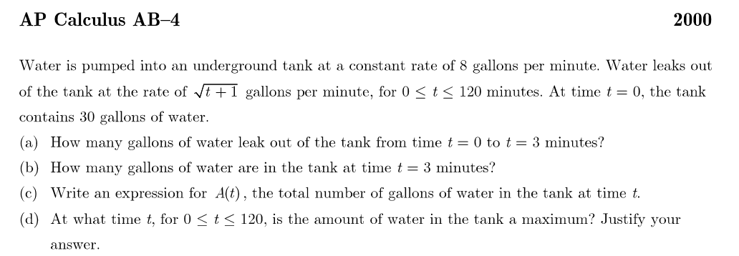
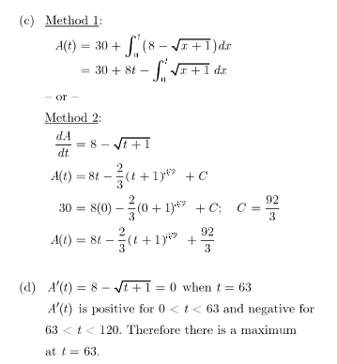
Type Question 1
Rate and Accumulation
Notes:
Rate = derivative = slope
Integral of rate = amount
Original + amount in – amount out. Recycle answer from part (a)
Same as b DON’T SIMPLIFY
Max/min – differentiate A(t) from c, OR Start over Rate in = Rate out
Three ways to do part (d): differentiate Method 1, start with derivative from Method 2, or start over and write A’(t). So, even if you miss (c), you can still do (d) Try all parts of each question. Use scoring guide as a template for written answers

Slide 20
Type Question 1
Rate and Accumulation
Rate and Accumulation
What students should be ready and able to do.
Example 2013 AB 1
Multiple-choice examples 2012 – 8, 81, 89
Notes:
What students should be ready and able to do.
Example 2013 AB 1
Multiple-choice examples 2012 – 8, 81, 89

Slide 21
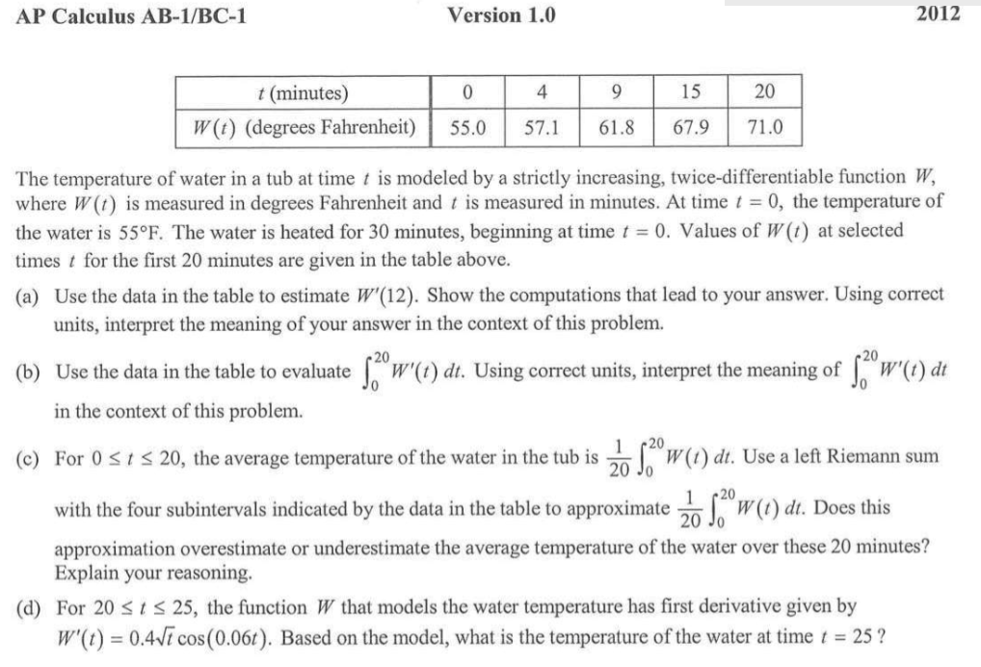
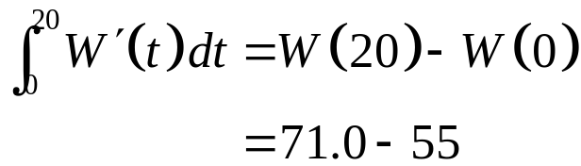
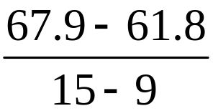
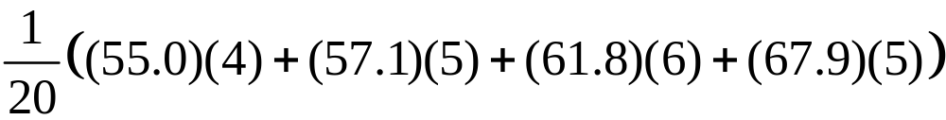

Type Question 1
Rate and Accumulation
Rate and Accumulation
Example 2013 AB 1
Multiple-choice examples 2012 – 8, 81, 89
The difference in the temperatures at t = 20 and t = 0 in degrees Fahrenheit
Notes:
Table stem !!
Estimate derivative = slope Show Quotient, but Don’t do arithmetic.
Integral of a rate is an amount and explain meaning of integral: Think FTC
Riemann sum, and over/under estimate (increasing therefore underestimate) but Don’t do arithmetic.
Final temperature = initial temperature + net change (integral of rate of change) CALCULATOR

Slide 22
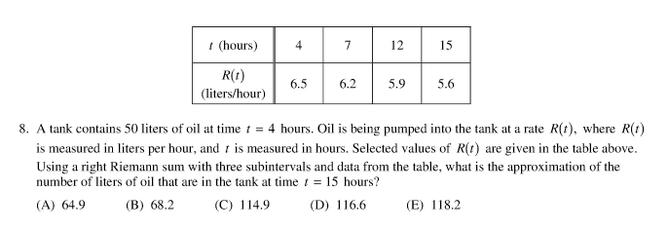
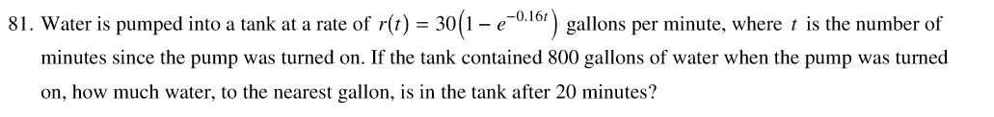
Type Question 1
Rate and Accumulation
Rate and Accumulation Multiple-choice from 2012 AB – 8, 81, 89
Notes:
Miultiple-choice
8. C Table: final amount = initial amount + net change (integral) + Riemann sum again.
81. D final amount = initial amount + net change (integral) CALCULATOR
89 E Linear motion - final velocity = initial velocity + accumulated acceleration CALCULATOR

Slide 23
Discussion, Questions, and Comments

Slide 24
Type 2
Linear Motion

Slide 25
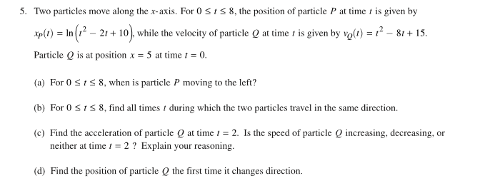
Type Question 2
Linear Motion
2017 AB 5
AP Calculus AB & BC: Reviewing for the Exam
Notes:
Analytic Stem
NOT calculator active, so there must be some commutations shown
Think similar things to graph analysis
Move left = decreasing
Move same directions = velocity same sign – standard shows number lines q.v.
Typical question Speed increasing or decreasing compare sign of v and a
Position = Q_0 + integral (0 to 3) = accumulation

Slide 26
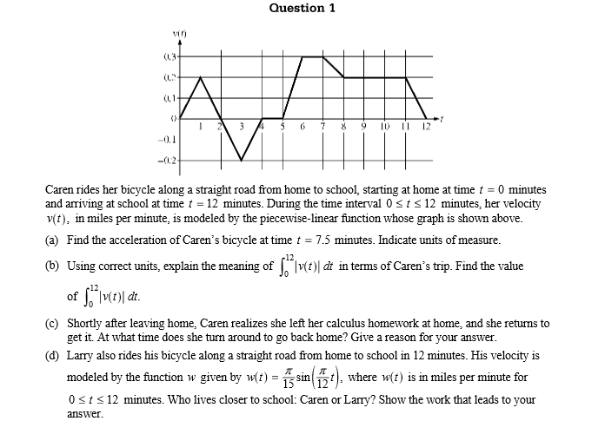
Type Question 2
Linear Motion
2009 AB1 BC1
AP Calculus AB & BC: Reviewing for the Exam
Notes:
Graph stem with analytic part (d)
Acceleration = slope of v Show quotient: 0.1 did not get credit.
Explain integral
Changes direction when v changes + to –
Analytic

Slide 27
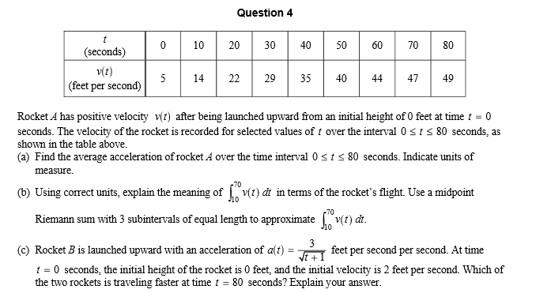
Type Question 2
Linear Motion
2006 AB 4
What students should be ready and able to do.
Notes:
Table Stem with analytic part (c)
Typical table question – don’t know what happens between values in table
(49 – 5)/(80 -0) don’t simplify
(b) displacement between t = 70 and t = 10, not distance traveled b/c don’t know what happens between values in table

Slide 28

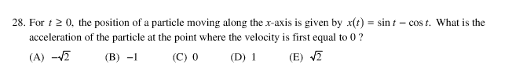
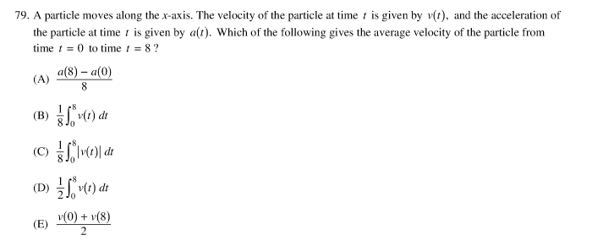
Type Question 2
Linear Motion
Multiple-choice questions from 2012
Notes:
D total distance = integral of speed
A find second derivative
79 B Average value of a function

Slide 29
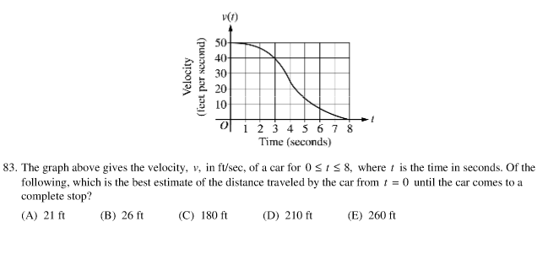
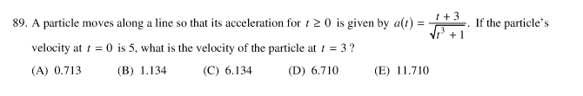
Type Question 2
Linear Motion
Multiple-choice questions from 2012
Notes:
D area = distance traveled; count squares
89 E Calculator accumulation 5 + integral (0 to 3) a(t)

Slide 30
Discussion, Questions, and Comments

Slide 31
Type 3
Function Analysis & Graphing

Slide 32
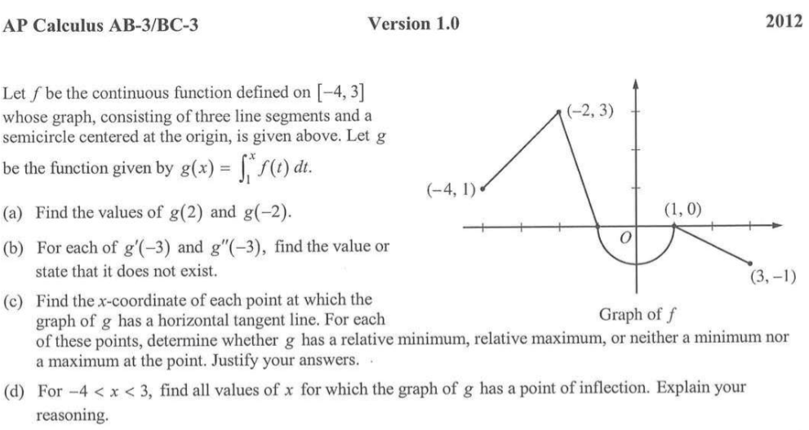

Type Question 3
Function / graph Analysis
What students should be ready and able to do.
Notes:
“Here’s the graph of the derivative; tell me about the function”
Somewhere say “g’(x) = f(x)” make the connection
Integrate
Read graph
Interpret graph – JUSTIFY YOUR ANSWER
Interpret from graph – EXPLAIN YOUR REASONING

Slide 33
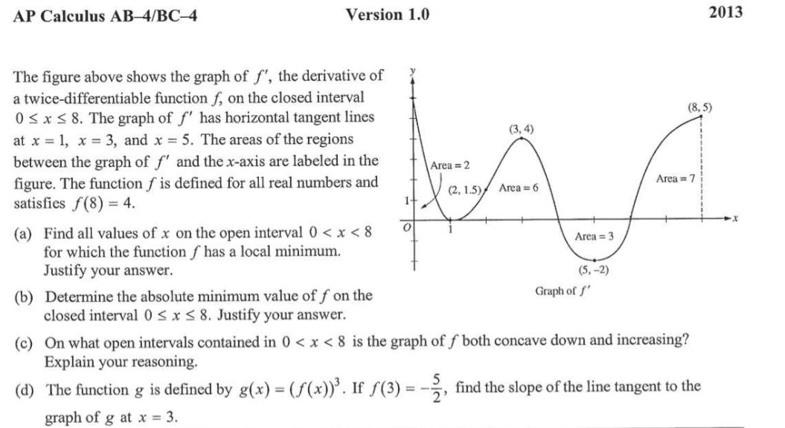
Type Question 3
Function / graph Analysis
Notes:
Interpret graph – JUSTIFY YOUR ANSWER
Interpret – JUSTIFY YOUR ANSWER
Extrapolate from graph – EXPLAIN YOUR REASONING
SWITCH - Analytic and find tangent line

Slide 34
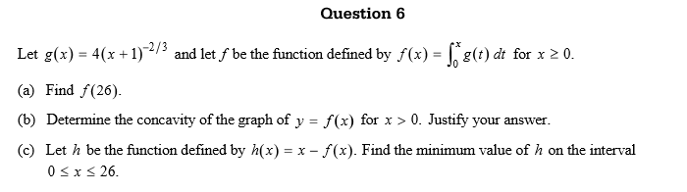
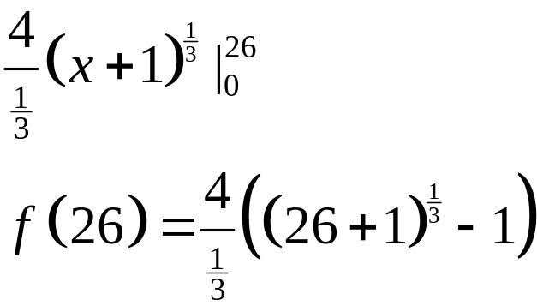
Type Question 3
Function / graph Analysis
2015 AB 6
Notes:
Analytic Stem
Integrate by hand – easy arithmetic but not necessary to do it!
Differentiate – JUSTIFY YOUR ANSWER
Extreme value

Slide 35
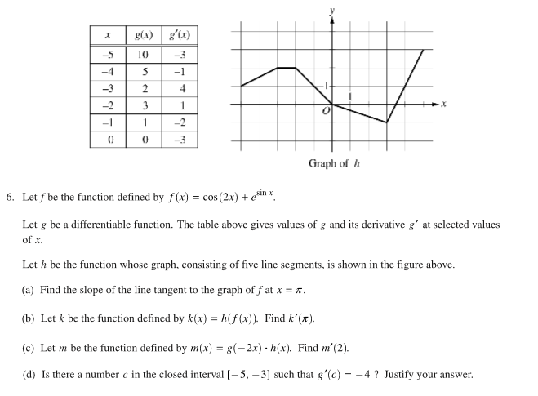
Type Question 3
Function / graph Analysis
2017 AB 6
Notes:
3 functions – defined differently: Table, graph, and analytic stem
Analytic
Chain rule (composition) w/ numbers from graph
Product rule w/ numbers from table and graph
Yes or No, MVT, JUSTIFY YOUR ANSWER – (yes there is)

Slide 36
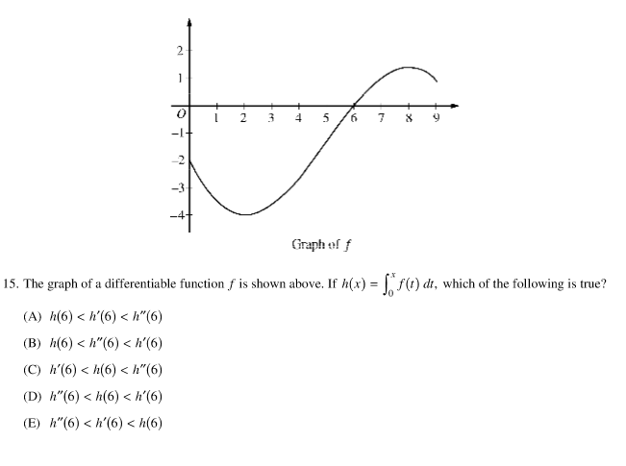
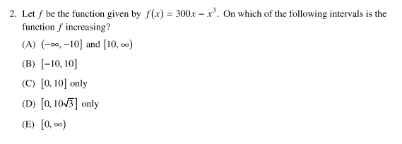
Type Question 3
Function / graph Analysis
2012 Multiple-choice
Notes:
B analytic inc/dec NOTE: All intervals are closed
15 A

Slide 37
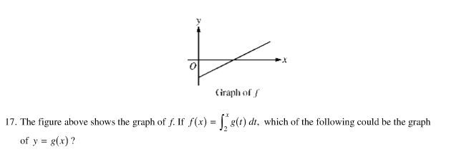
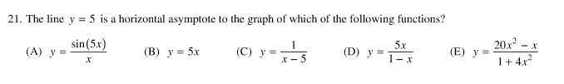
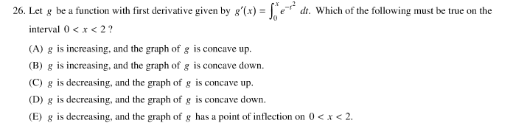
Type Question 3
Function / graph Analysis
2012 AB Multiple-choice
Notes:
A
E
26 A

Slide 38
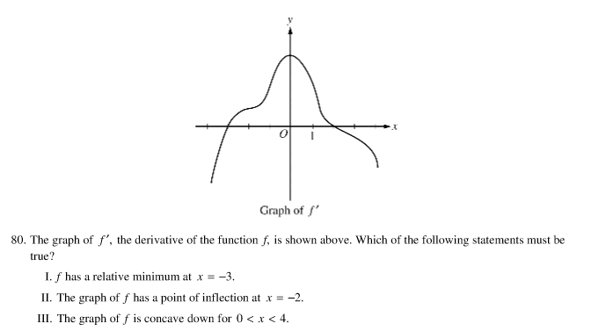
Type Question 3
Function / graph Analysis
2012 Multiple-choice
The triple True-False question
Notes:
80 E Discuss True – False questions
Require reasons
Sometimes, Always, or Never

Slide 39

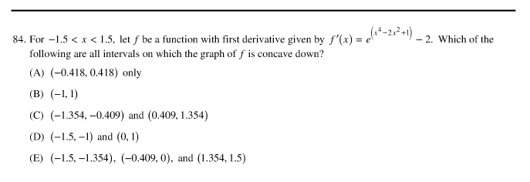
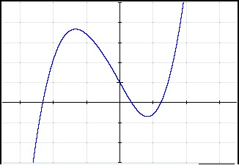
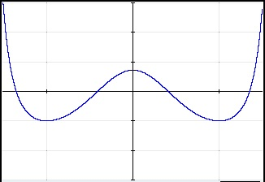
Type Question 3
Function / graph Analysis
2012 Multiple-choice
Calculator Active Questions
Notes:
Even though calculator active, students still must know how to analyze the derivative
82. C Must know what features of the derivative will indicate a local maximum
Set window relative to the answer choices
Estimate answer
84. D Need to know what features of the derivative tell you about concavity.
Window sides are given, adjust top and bottom
Estimate answers – no real decimal work needed
NOTE: ALL open intervals No need to worry about endpoints.

Slide 40
Discussion, Questions, and Comments

Slide 41
Type 4
Area & Volume

Slide 42
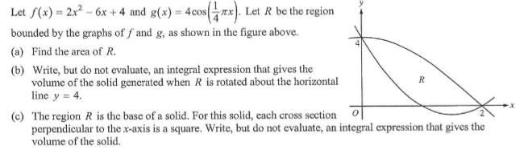
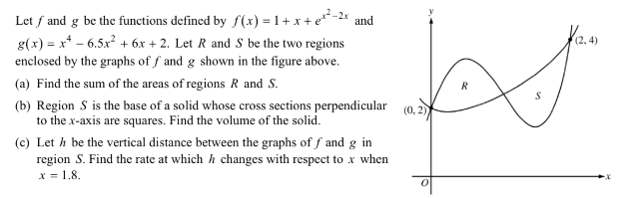
Type Question 4
Area / Volume Questions
2013 AB 5
2015 AB 2
What students should be ready and able to do.
Notes:
2013 AB 5 Typical
2015 AB 2 CALCULATOR REQUIRED
Absolute value
(c) Related Rate

Slide 43
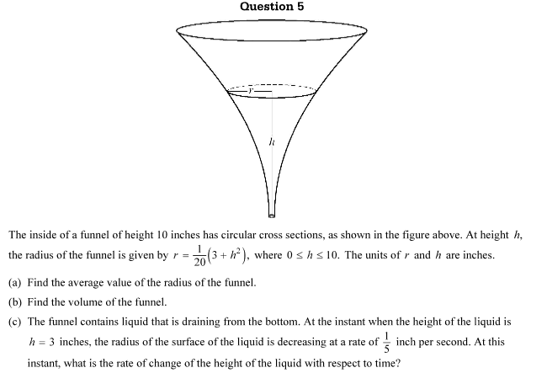
Type Question 4
Area / Volume Questions
2016 AB 4 Atypical
Notes:
An atypical problem
(a) Is an average value problem
(c) Related Rates

Slide 44

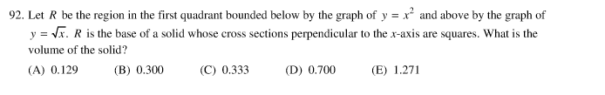
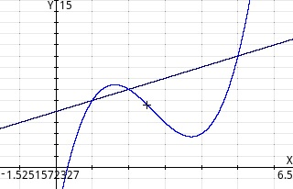

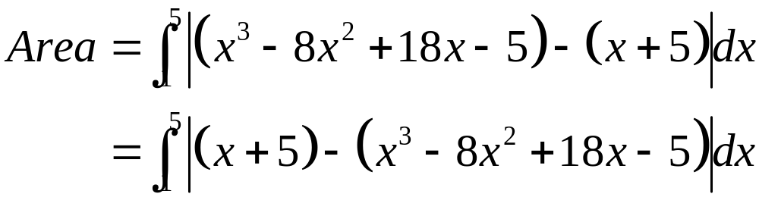
Type Question 4
Area / Volume Questions
2012 Multiple-choice
2008 AB 83
Notes:
10 A
92 A
83 B Use absolute values and calculator

Slide 45
Discussion, Questions, and Comments

Slide 46
Type 5
Table & Riemann Sums

Slide 47
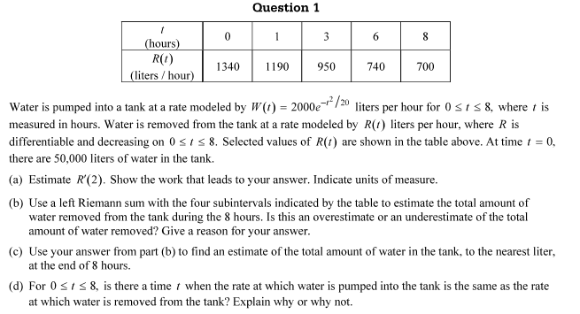
Type Question 5
Table / Riemann Sums
2016 AB 1
What students should be ready and able to do.
Notes:
(d) IVT

Slide 48
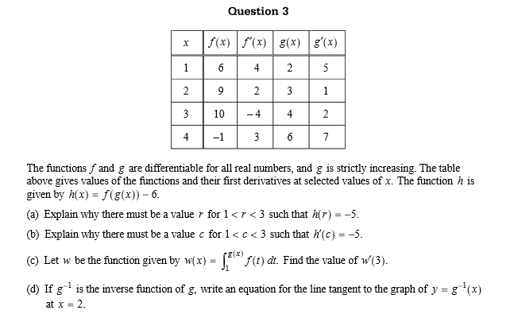
Type Question 5
Table / Riemann Sums
2007 AB 3
Notes:
Mean score = 0.97 out of 9

Slide 49

Type Question 5
Table / Riemann Sums
2016 AB 6

Slide 50


Type Question 5
Table / Riemann Sums
2012 Multiple-choice
Notes:
C
91 B Five T-F questions

Slide 51


Type Question 5
Table / Riemann Sums
Notes:
2012 86 B Process of elimination C & D not increasing everywhere, Since integral is zero, there must be positive and negative values, eliminates A and D

Slide 52
Discussion, Questions, and Comments

Slide 53
Type 6
Differential Equations

Slide 54




Type Question 6
Differential Equation
2016 AB 4
Notes:
2016 AB 4 typical
Slope Field
Tangent line approximation – solution not needed
Solve DE and IVP
BC 4 – parts a. b. and c are suitable for AB Note: you never have to solve the DE.
Implicit second derivative
Second derivative test required
L’Hospital’s Rule
Euler's method BC topic

Slide 55





Type Question 6
Differential Equation
2016 BC 4
Notes:
NOT Typical
BC 4 – parts a. b. and c are suitable for AB Note: you never have to solve the DE.
Implicit second derivative
Second derivative test required
L’Hospital’s Rule
Euler's method BC topic

Slide 56





Type Question 6
Differential Equation
2017 AB 4 – An atypical DE question
What students should be ready and able to do.
Notes:
2017 AB 4 – an atypical question.
Tangent line approximation
Implicit second derivative, approximation, over/under estimate
Solve DE NOTE: on separating the right side is just dt; this bothered some students.
Domains

Slide 57


Type Question 6
Differential Equation
2012 AB Multiple-choice questions
Notes:
A AB/BC Common BC had a similar question re: Logistic equation.
25 E

Slide 58


Type Question 6
Differential Equation
2012 BC Multiple-choice questions
Notes:
Not separable C discuss how to solve find y’’ and substitute into y’ and y’’ ; y’’ = 2x + x^2+y
SECOND DERIVATIVE TEST REQUIRED
16 C BC topic

Slide 59
Discussion, Questions, and Comments

Slide 60
Type 7
Miscellaneous

Slide 61
Type Question 7
Miscellaneous
Occasionally, part of an other question, sometimes an entire question.
These include
Finding derivatives using the chain rule, the quotient rule, etc. from tables of values:
Implicit differentiation
L'Hospital's Rule
Continuity and piecewise defined functions:
Related rate:
Arc length (BC Topic)
Partial fractions (BC Topic)
Improper integrals (BC topic):
What students should be ready and able to do.
Notes:
Finding derivatives using the chain rule, the quotient rule, etc. from tables of values: 2016 AB 6 and 2015 AB 6
Implicit differentiation 2004 AB and 2016 BC 4
L'Hospital's Rule 2016 BC 4
Continuity and piecewise defined functions: 2012 AB 4, 2011 AB 6 and 2014 BC 5
Related rate: 2014 AB4/BC4, 2016 AB5/BC5
Arc length (BC Topic) 2014 BC 5
Partial fractions (BC Topic) 2015 BC 5
Improper integrals (BC topic): 2017 BC 5

Slide 62

Type Question 8
Parametric Equations
2012 BC 2

Slide 63

Type Question 8
Parametric Equations
2016 BC 2
What students should be ready and able to do.

Slide 64



Type Question 8
Parametric Equations
Multiple-choice 2008
.
Notes:
B
C
28. D

Slide 65
Discussion, Questions, and Comments

Slide 66
Type 9
Polar Equations

Slide 67

Type Question 9
Polar Equations
2017 BC 2

Slide 68

Type Question 9
Polar Equations
2014 BC 2
What students should be ready and able to do.

Slide 69

Type Question 9
Polar Equations
Multiple-choice 2008
Notes:
26. D
Note: limits of integration force you to find area of half the figure and double it.

Slide 70


Type Question 9
Polar Equations
Multiple-choice 2012
Notes:
A
91. B Geometry

Slide 71
Type 10
Sequences & Series

Slide 72


Type Question 10
Sequences & Series
2015 BC 6
Notes:
Ratio test and check endpoints [5]
Substitute to find new series [2]
Lagrange Error Bound [2]

Slide 73

Type Question 10
Sequences & Series
2016 BC 6
What students should be ready and able to do.

Slide 74




Type Question 10
Sequences & Series
Multiple-choice questions from 2012
Notes:
5 Geometric C
9 Sequences D triple T-F
13 Radius of Convergence C
17 C Recognize series for common function

Slide 75


Type Question 10
Sequences & Series
Multiple-choice 2012 (8 questions)
Notes:
D interval of convergence extends at least from 3 to 5 so radius is 2 or more.
27 C p-series and geometric series

Slide 76


Type Question 10
Sequences & Series
Multiple-choice 2012 (8 questions)
Notes:
E
90 E

Slide 77
Discussion, Questions, and Comments

Slide 78
Welcome!
Lin McMullin
Moderator, AP Calculus Community
AP Calculus AB & BC teacher for 30 years
AP Consultant since 1991
National Director of Mathematical Programs for the National Math and Science Initiative (2008 – 20012)
Author of Teaching AP Calculus
Blogger at TeachingCalculus.com
Links to resources for this session and a copy of the PowerPoint slides may be found here
www.TeachingCalculus.com > Presentations > Mass Insight
AP Calculus AB & BC: Reviewing for the Exam
Notes:
Read last bullet

