Slide 1
Problems for CAS Solution
Lin McMullin
TTT & USACAS Conference 2013

Slide 2
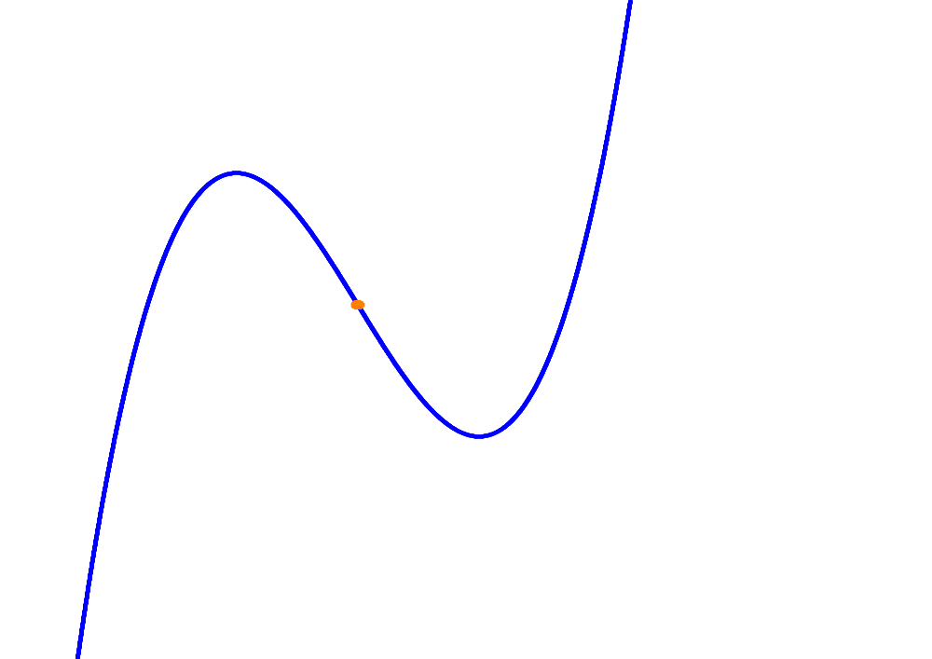





Cubic Symmetry
Show that any cubic polynomial has a point of rotational symmetry.

Slide 3
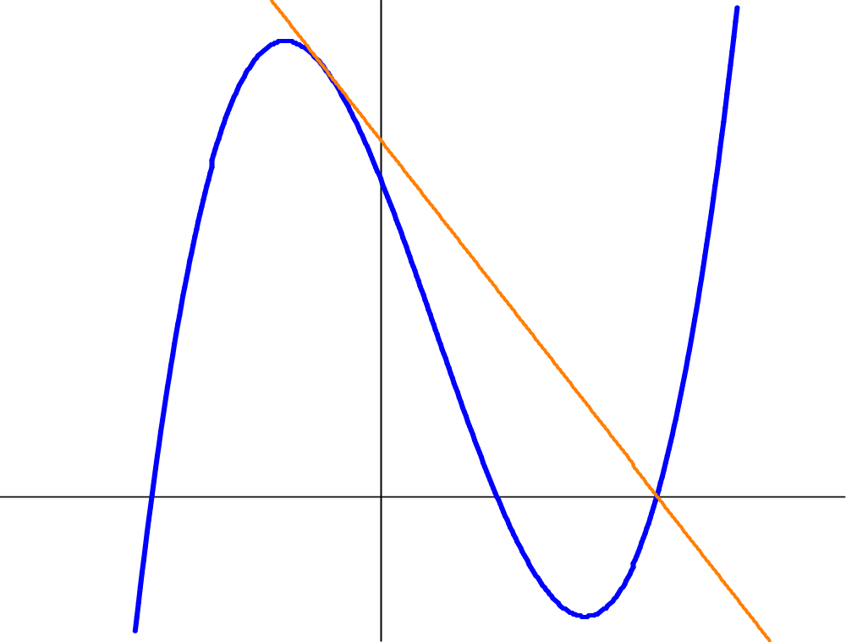
Roots of a Cubic

Slide 4
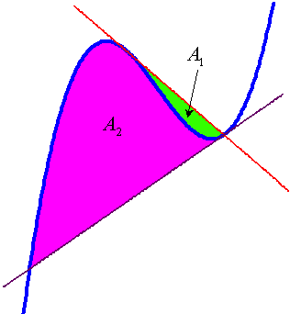
A Cubic Problem

Slide 5
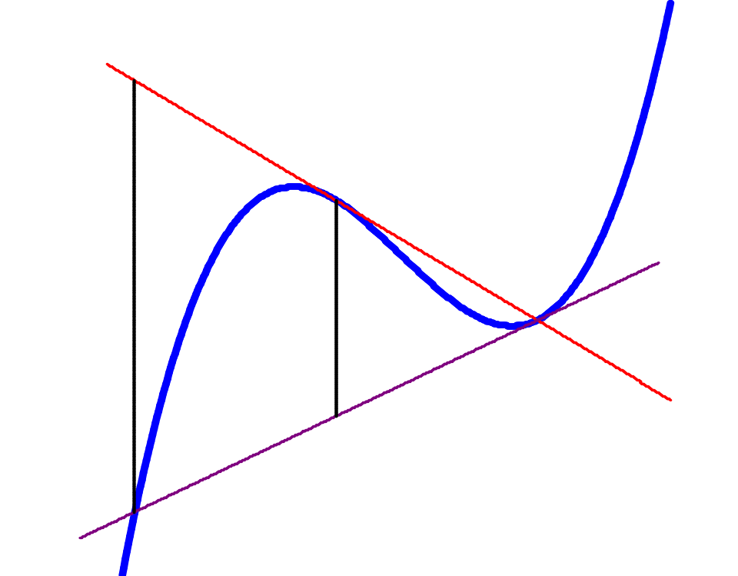

A Cubic Problem

Slide 6






Trigonometry
SSS triangle.

Slide 7





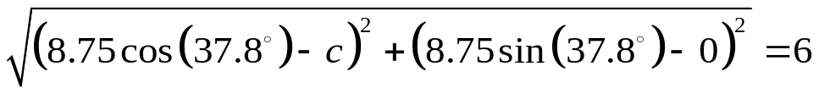
Trigonometry
SSA triangle.
This approach can be used for SAS as well.

Slide 8







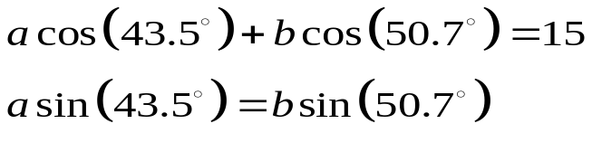
Trigonometry
ASA triangle.

Slide 9
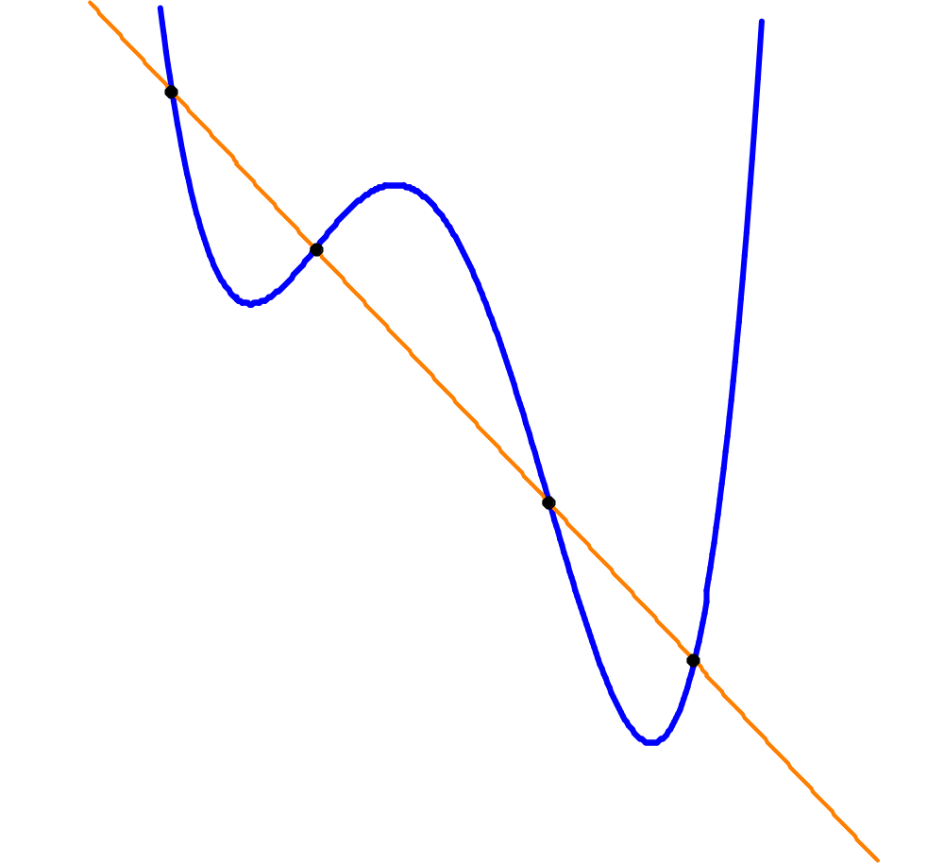
Lin McMullin’s Theorem

Slide 10
How is DOING Math Different with a CAS?
The CAS does the algemetic so we can concentrate on the mathematics.
You can improve the CAS by adding your own operations and routines.
New approaches are possible once you stop worrying about the algemetic.
“Go for the equation.”
Complicating can make the work go faster.
One still needs to know mathematics.

Slide 11
Implications for teaching
Good CAS use is a new skill, a new tool that students must be taught and encouraged to learn.
To do this we need
  A willingness to accept new ways of doing problems
  A new style of showing work
  A change in how we think about “simplifying”
  A good source of better problems for students to attempt

Slide 12
DOING Math with a CAS
The text of this presentation along with the slides, examples and solutions are available at
www.LinMcMullin.net
Click on “CAS”

Slide 13
DOING Math with a CAS
Lin McMullin
USACAS Conference 2013

