Slide 1
The Ubiquitous
Particle Motion Problem
Presented by
Lin McMullin
NCTM Annual Meeting 2013

Slide 2
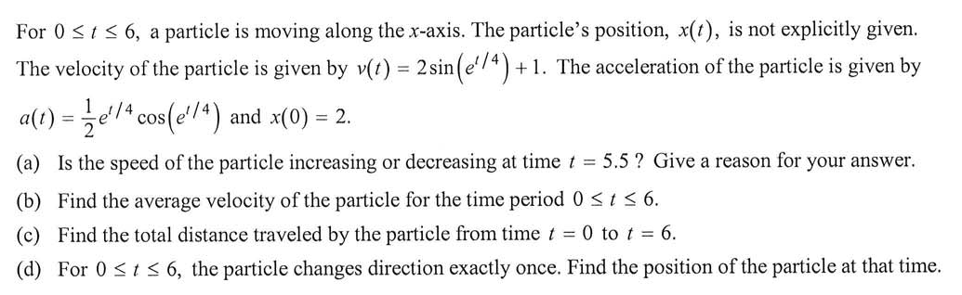
A Quick Look at Some Questions
2011 AB 1

Slide 3
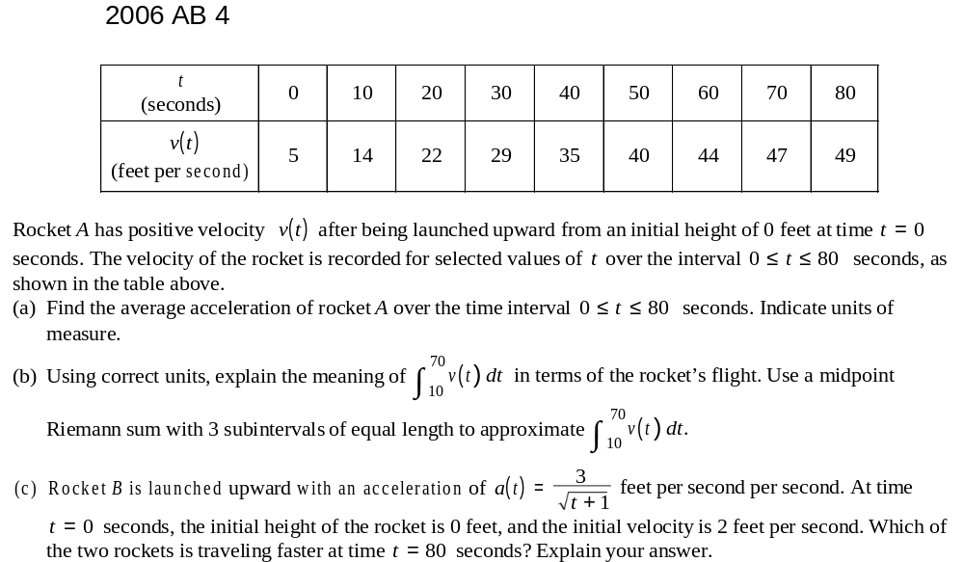
A Quick Look at Some Questions

Slide 4
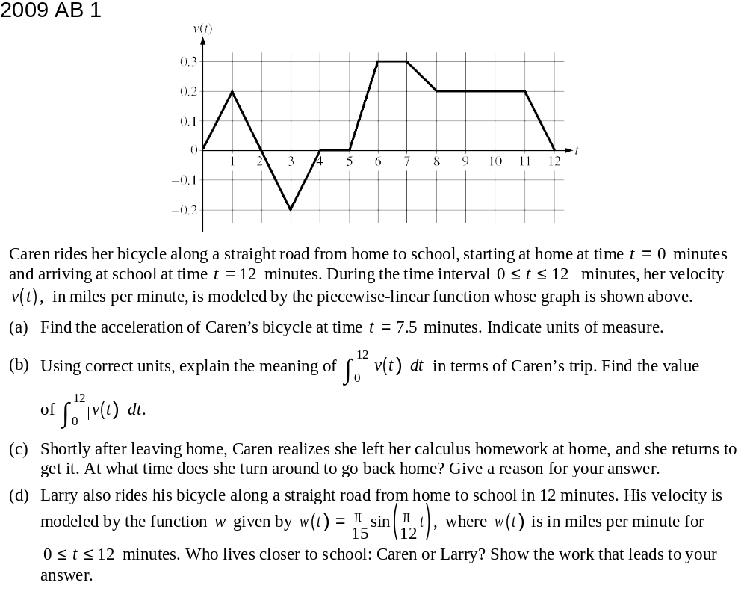
A Quick Look at Some Questions

Slide 5

Velocity
The velocity is the derivative of the position,
Velocity is has direction (indicated by its sign) and magnitude. Technically, velocity is a vector; the term “vector” will not appear on the AB exam.
Velocity is the antiderivative of the acceleration
Position is the antiderivative of velocity.

Slide 6

Acceleration
Acceleration is the derivative of velocity and the second derivative of position,
It has direction and magnitude and is a vector.
Velocity is the antiderivative of the acceleration

Slide 7
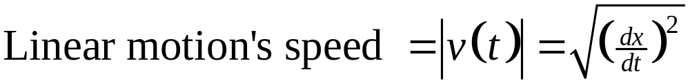
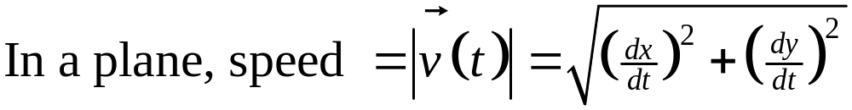
Speed
Speed is the absolute value of velocity
Speed is the length of the velocity vector
Speed is a number, not a vector.

Slide 8
Speed
How to determine if the speed is increasing or decreasing:
  If the velocity and acceleration have the same sign, then the speed is increasing.
  If velocity and acceleration have different signs, the speed is decreasing.
  If the velocity graph is moving away from (towards) the t-axis the speed is increasing (decreasing).

Slide 9

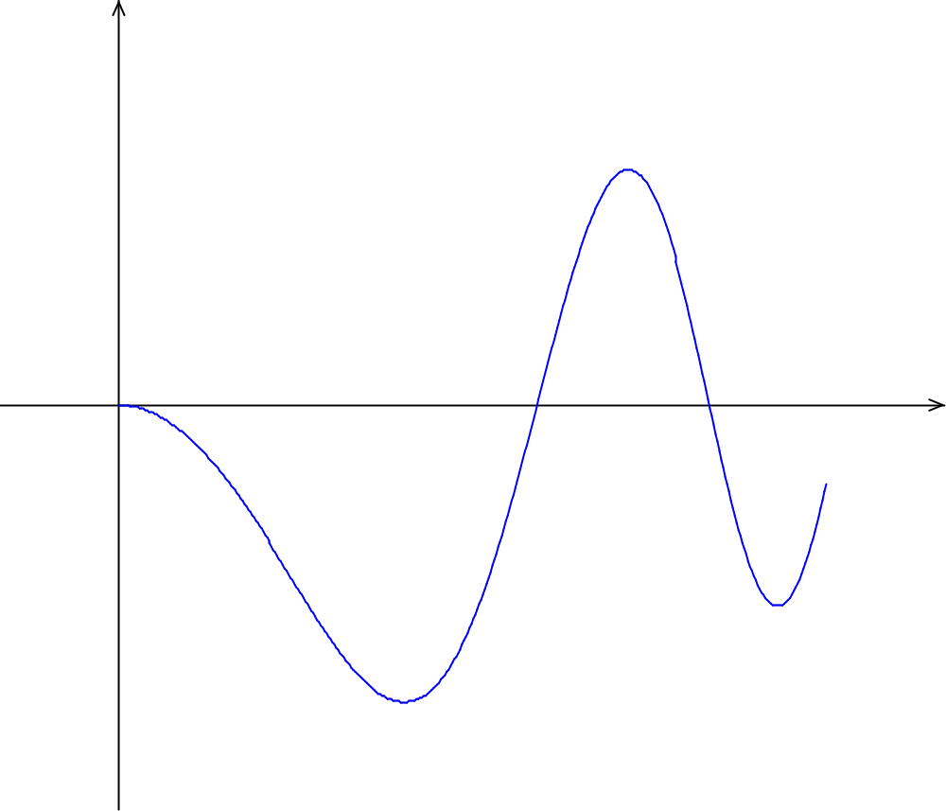






Speed

Slide 10

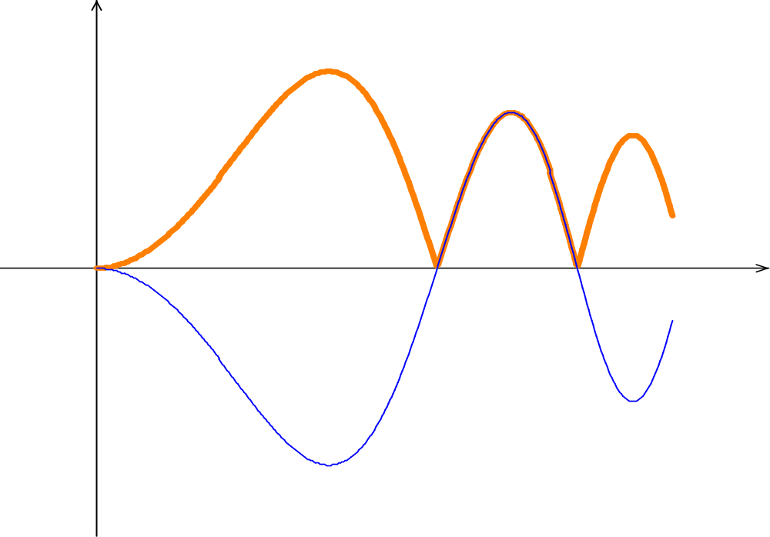





Speed

Slide 11
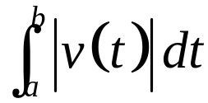
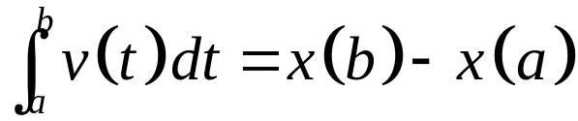
Distance
The total distance traveled is the definite integral of the speed
The net distance traveled (displacement) is the definite integral of the velocity (rate of change)

Slide 12
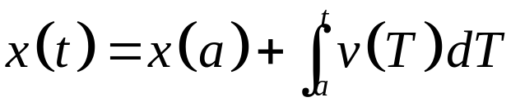
Position
The final position is the initial position plus the net distance traveled from x = a to x = t:
Notice that this is an accumulation function equation.

Slide 13
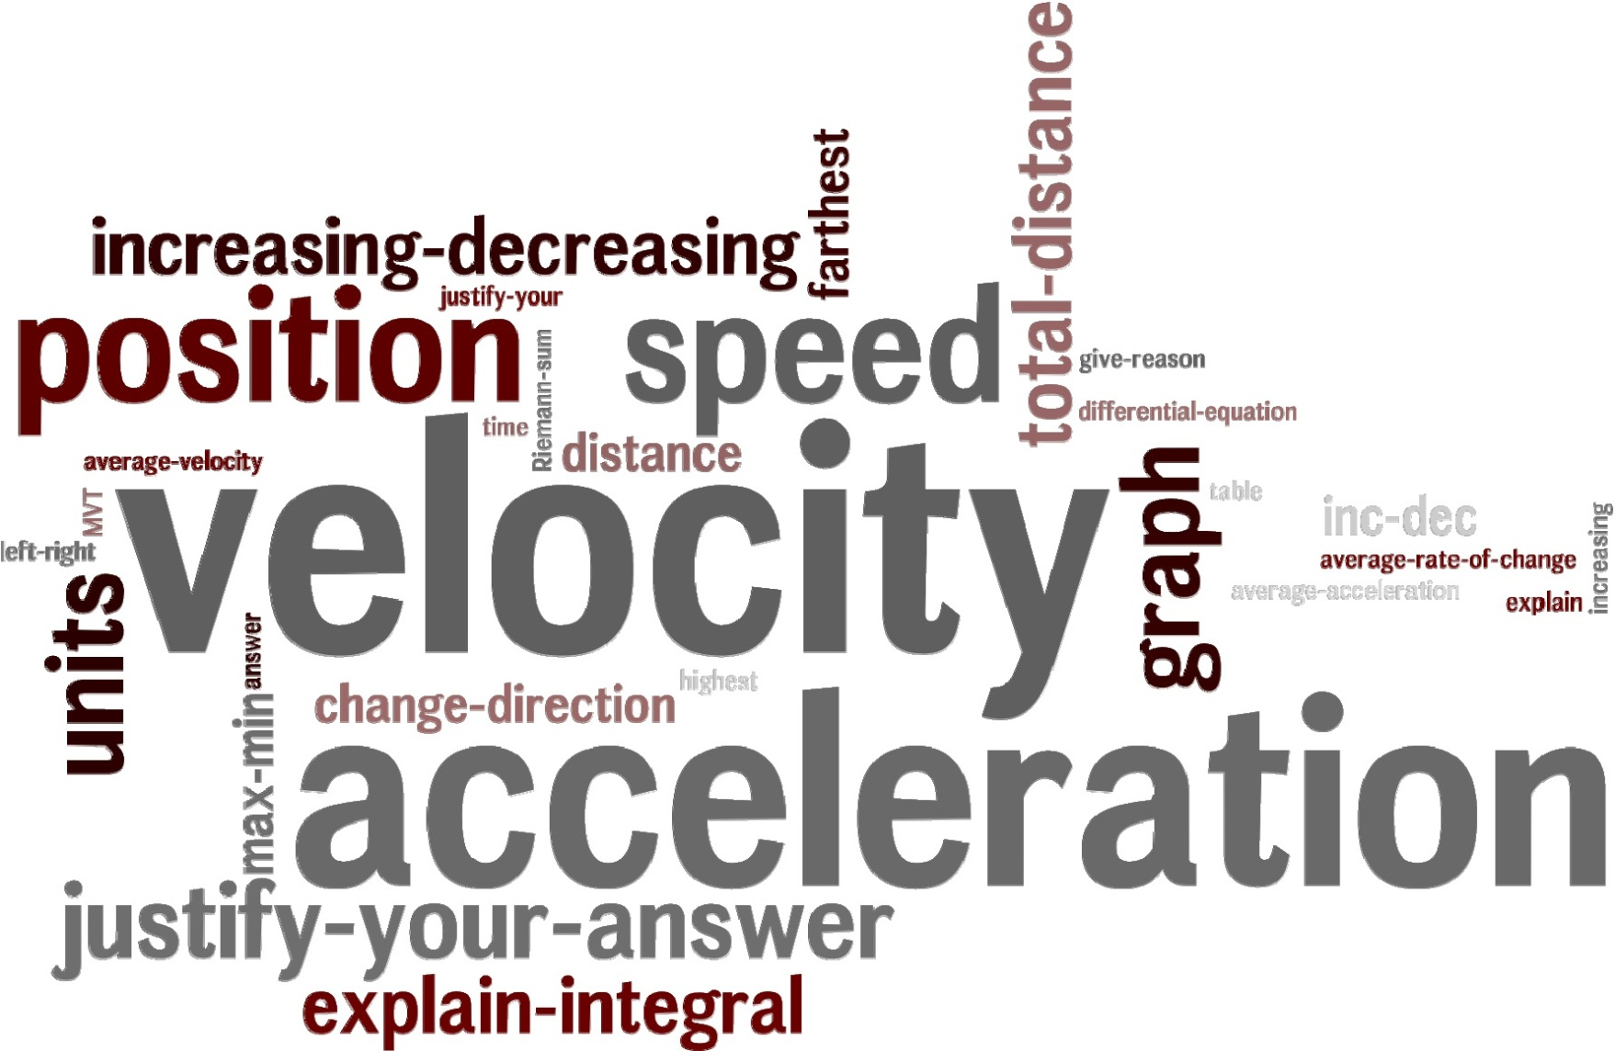

Slide 14
Corresponding Concepts
Function | Linear Motion
Value of a function at x | Position at time t
First derivative | Velocity
Second derivative | Acceleration
Increasing | Moving to the right or up
Decreasing | Moving to the left or down
Absolute Maximum | Farthest right or up
Absolute Minimum | Farthest left or down
y ʹ = 0. | “At rest”
y ʹ changes sign | Object changes direction
 | Speed
y ʹ positive and increasing | Speed is increasing
y ʹ negative and increasing | Speed is decreasing
y ʹ positive and decreasing | Speed is decreasing
y ʹ negative and decreasing | Speed is increasing

Slide 15
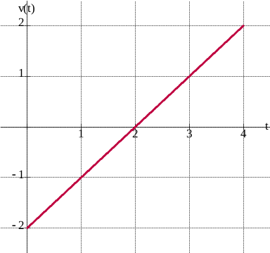
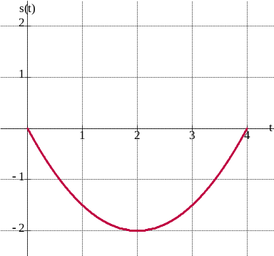
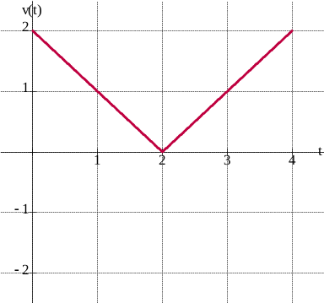
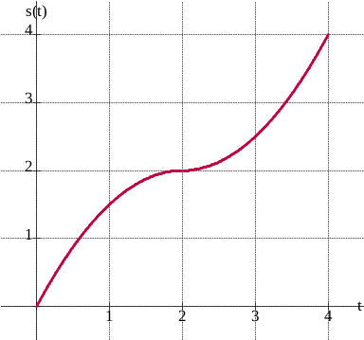
Velocity Matching Game
A. Changes direction at 2 seconds
D. Stops at 2 seconds
K. This particle travels a net distance of 0 over the four seconds.
L. This particle slows down and then speeds up.
C. This particle travels to the right the entire four seconds.
D. Stops at 2 seconds
L. This particle slows down and then speeds up.
By Brian Leonard,
Lake Hamilton (AR) High School

Slide 16
A Quick Look at Some Questions
2011 AB 1

Slide 17
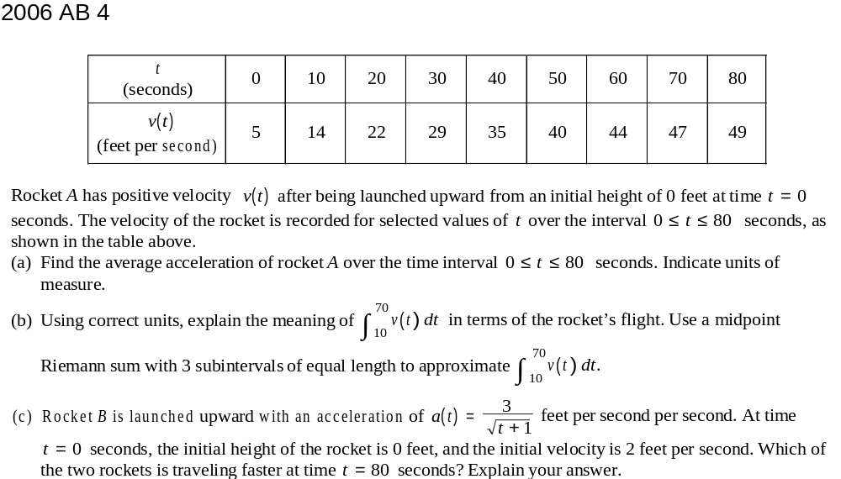
A Quick Look at Some Questions

Slide 18

A Quick Look at Some Questions

Slide 19
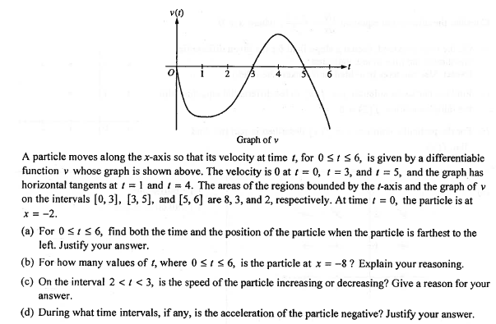
A Quick Look at Some Questions
2008 AB 4

Slide 20
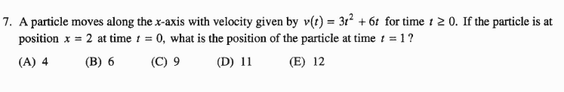
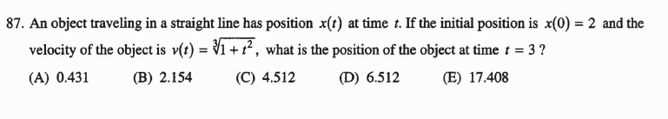
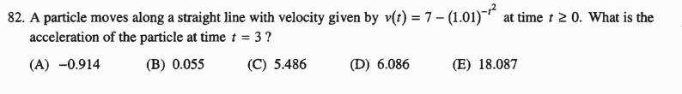
Multiple-choice from AB 2008

Slide 21
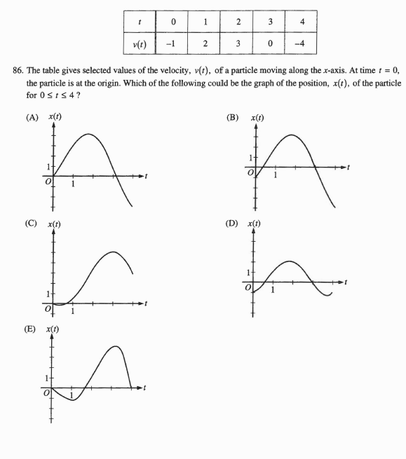

Slide 22
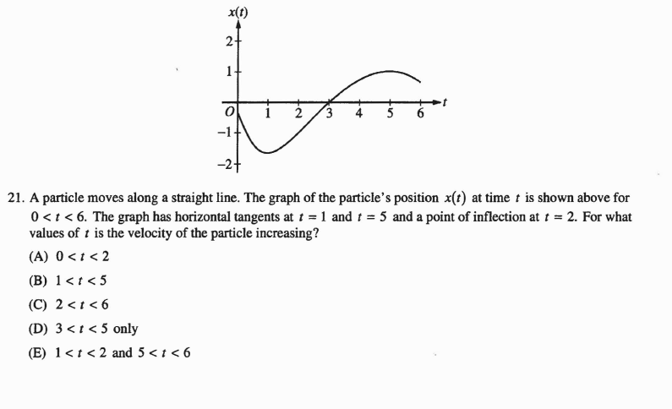
Multiple-choice from AB 2008

Slide 23
Website:
www.LinMcMullin.net
Blog:
TeachingCalculus.wordpress.com
E-mail:
lnmcmullin@aol.com

