Slide 1
Here’s the Graph of the Derivative ….
Tell me About the Function
Lin McMullin
Calculus for AP* by Rogawski and Cannon
Webinar February 15, 2012

Slide 2
AP Calculus
Free-response Questions
Standard
Synthesis
Area – Volume
Differential Equation
Functions
Power Series (BC)
Polar, Parametric & Vector (BC)
Rate / Accumulation
Particle Motion
Table Stem
Graph Stems
Family/Generic Functions
Notes:
Comprehensive are not so much in the textbooks etc.

Slide 3
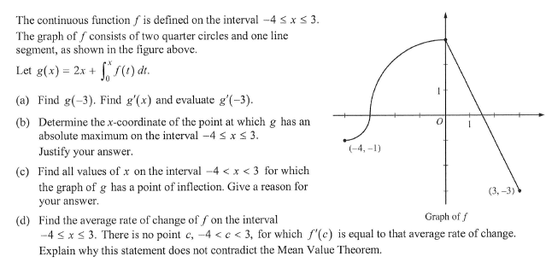
2011 AB 4

Slide 4
AP Calculus
Graph-stem Questions
2011 AB 4 / BC 4 The graph of the derivative Stem: Graph
(a) f defined by integral | - | - | 5.4
FTC | 5.3 | 4.4 | 5.4
Evaluate from graph g, g' (and g'') | - | 4.4 | 5.4
(b) max/min | 4.3, 4.7 | (3.6) | 4.3
Justify | - | - | -
(c) POI | 4.4 | 3.4 | 4.3
Give reason | - | - | -
(d) Average ROC | 2.1 | (P1) | 2.4
MVT | 4.3 | 3.2 | 4.2

Slide 5
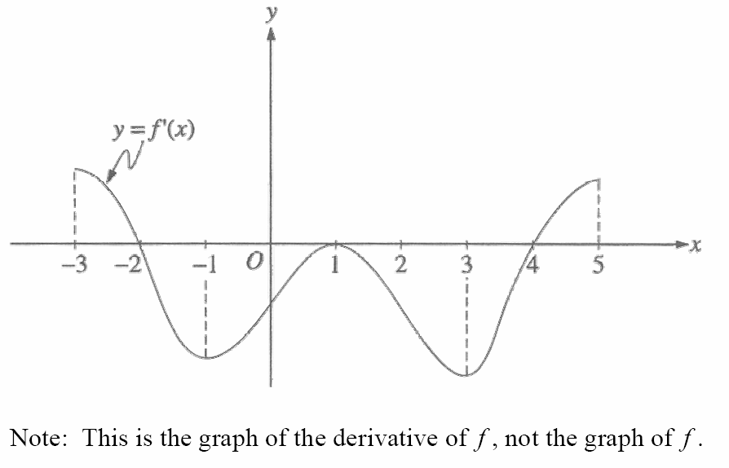
AP Calculus
Graph-stem Questions
1996 AB 1
Notes:
They asked for
a. Relative maximum, why?
b. Relative minimum, why?
c. Concave up – interval Justify
d. Sketch the graph such that f(0) = 1 on [0,2]

Slide 6
AP Calculus
Graph-stem Questions
1996 AB 1
Increasing
Decreasing
Increasing
Absolute Maximum
Local Max
POI
Local Min
POI
Absolute Minimum
POI
Down
Up
Down
Up
Notes:
They asked for
a. Relative maximum, why?
b. Relative minimum, why?
c. Concave up – interval Justify
d. Sketch the graph such that f(0) = 1 on [0,2]

Slide 7
AP Calculus
Graph-stem Questions
Year & Number | Mean | % 9 | % Zero
2003 AB 4 | 2.68 | n/a | 20.4
2004 AB 5 | 2.63 | 1.0 | 28.0
2006 AB 3 | 3.24 | 4.0 | 22.0
2008 AB 4 | 2.60 | 2.3 | 29.7
2009 AB 1 | 4.67 | 4.9 | 9.6
2009 AB 6 | 2.07 | 0.2 | 23.8
2010 AB 5 | 1.75 | 0.3 | 38.9
2011 AB 5 | 2.44 | 0.4 | 29.5
Notes:
Why?
Not in textbooks
Parts from different parts of the textbook
“below expectations” 2011
Performed “very poorly” 2010
2009 1 “performed well”
2009 6 performance was “generally poor”
2008 performance “varied widely”
2004 “relatively poorly”
2003 a “disappointment”
Problems: arithmetic/algebra, communications skills – integrals and justifications
“weakness in verbal communication”
2006 “Students need to improve their ability to interpret graphical data”

Slide 8
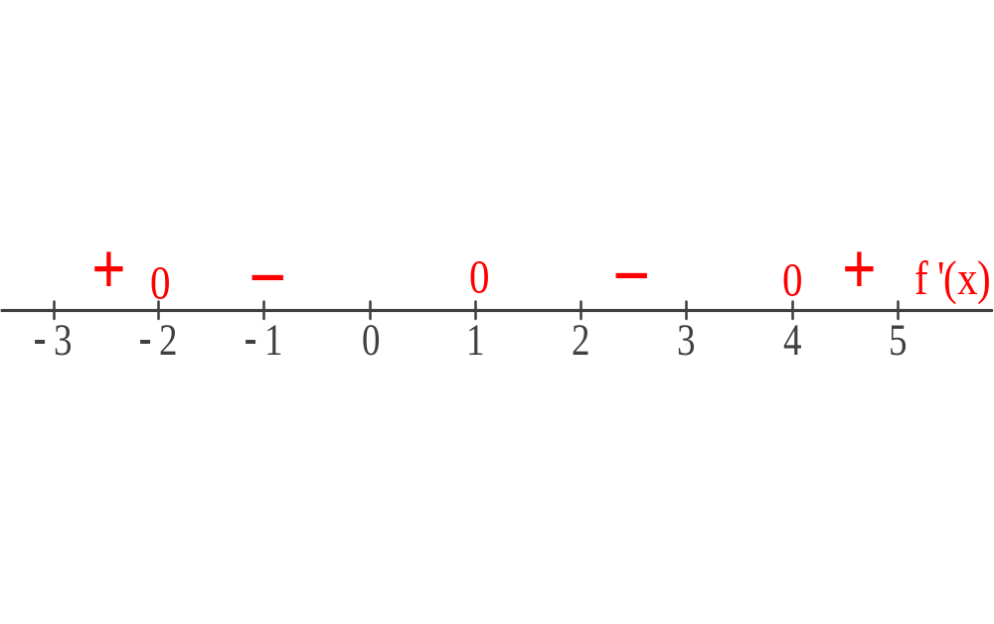
AP Calculus
Graph-stem Questions

Slide 9
AP Calculus
Graph-stem Questions
Method 1 Think Tangent Line
The derivative is the slope of the tangent line and we see the graph mimics the tangent line, so we turn that around and use these ideas ….
Rogawski §4.4 First Applet
Winplot Demo

Slide 10
AP Calculus
Graph-stem Questions
Feature | Conclusion
y' > 0 | y is increasing
y' < 0 | y is decreasing
y' changes - to + | y has a local minimum
y' changes + to - | y has a local maximum
y' increasing | y is concave up
y' decreasing | y is concave down
y' extreme values | y has points of inflection
Notes:
First Derivative Test
Note the concern with sign change, not y’ = 0
Discuss x = 1 on 1996 AB 1: decreasing – horizontal tangent – decreasing.

Slide 11
AP Calculus
Justifications
Conclusion | Justification
y is increasing | y' > 0
y is decreasing | y' < 0
y has a local minimum | y' changes - to +
y has a local maximum | y' changes + to -
y is concave up | y' increasing
y is concave down | y' decreasing
y has points of inflection | y' extreme values
Notes:
First Derivative Test
Note the concern with sign change, not y’ = 0
Discuss x = 1 on 1996 AB 1: decreasing – horizontal tangent – decreasing.

Slide 12
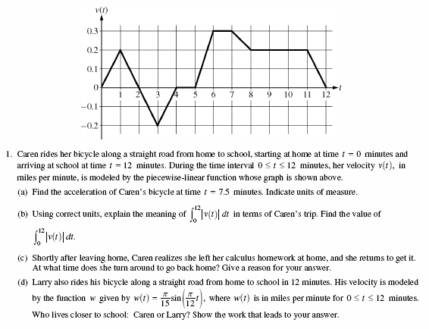
AP Calculus
Graph-stem Questions
2009 AB 1
Notes:
Note: A motion problem
vocabulary
Acceleration = second derivative = slope
Meaning of integral and find value
She turns around at a local extreme value = graph crosses + to –
Find distance from integral = more usual question
(d) Karen 1.4 miles

Slide 13
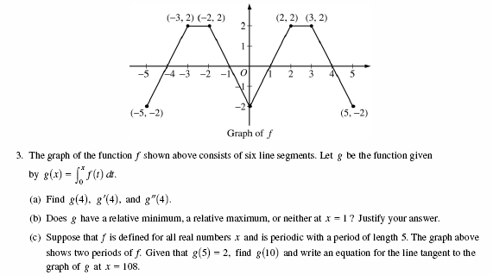
AP Calculus
Graph-stem Questions
2006 AB 3
Notes:
FTC function defined by an integral
g’’ = slope of g’ = slope of f
Max/min and justify
Periodic function: write tangent line = point (108, 44) and f(108) = 2
What else could you ask?
What could you ask in earlier grades?

Slide 14
AP Calculus
Graph-stem Questions
Method 2 Accumulation
The given might include the graph of and ask about
Here we use the Fundamental Theorem of Calculus to see that with the initial condition
Notes:
C may or may not be an endpoint

Slide 15
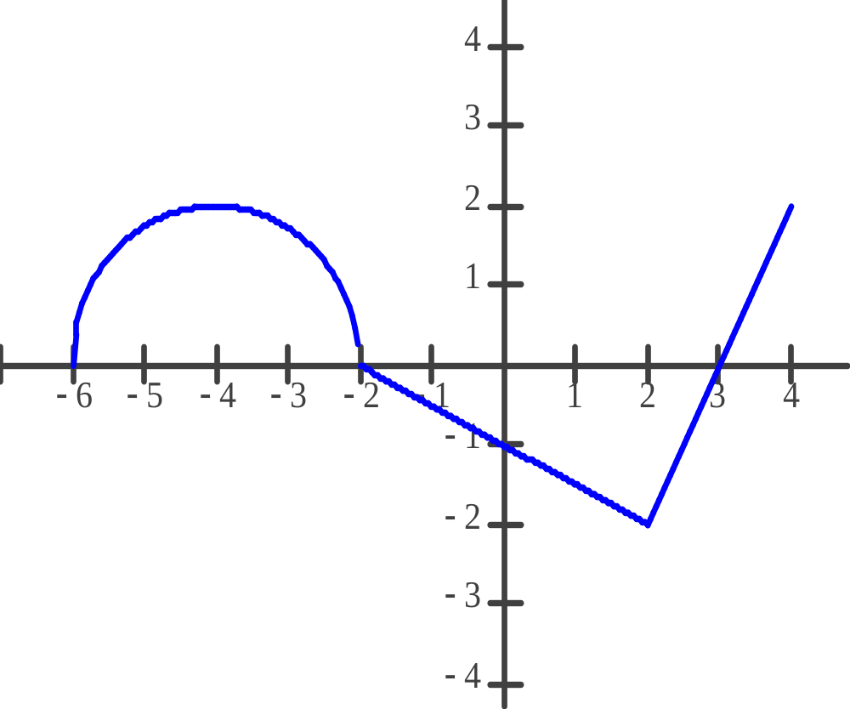
Graphing without Derivatives
(The graph of f consists of a semicircle and two line segments)
Tell me all the usual stuff about the graph of and explain your reasoning without mentioning the derivative or any concepts related to the derivative.
Notes:
C may or may be an endpoint

Slide 16
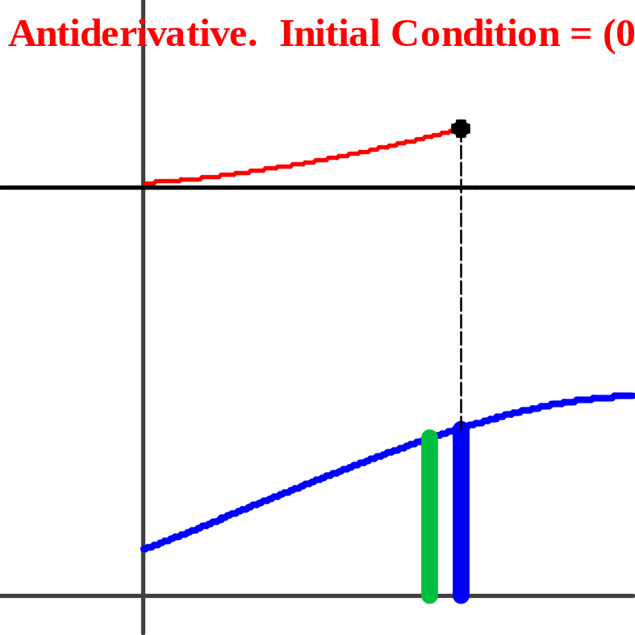
Graphing without Derivatives
Winplot Demo 2

Slide 17
Graphing without Derivatives
Notes:
C may or may be an endpoint

Slide 18
Graphing without Derivatives
Notes:
C may or may be an endpoint

Slide 19
Graphing without Derivatives
x | g(x)
-6 | ?
-4 | ? + π
-2 | ? + 2π
0 | ? + 2π –1 = 7 ? = 8 – 2π
2
3
4
Notes:
C may or may be an endpoint
Discuss Riemann sum terms with negative function values
Area “below the graph”

Slide 20
Graphing without Derivatives
x | g(x)
-6 | 8 – 2π
-4 | 8 – π
-2 | 8
0 | 7
2 | 7 – 3 = 4
3 | 4 – 1 = 3
4 | 3 + 1 = 4
Notes:
C may or may be an endpoint

Slide 21
Graphing without Derivatives
x | g(x)
– 6 | 8 – 2π
– 4 | 8 – π
– 2 | 8
0 | 7
2 | 4
3 | 3
4 | 4
Location | Feature | Concavity
(-6, 8 – 2π) | Absolute minimum
– 6 ≤ x ≤ – 2 | Increasing
(– 2, 8) | Absolute Maximum
– 2 ≤ x ≤ 3 | Decreasing
(3,3) | Local Minimum
3 ≤ x ≤ 4 | Increasing
(4, 4) | Endpoint Maximum
Notes:
C may or may be an endpoint

Slide 22
Graphing without Derivatives
Location | Feature | Concavity
(– 6, 8 – 2π) | Absolute minimum | –
– 6 ≤ x ≤ – 4 | Increasing | Up
(– 4, 8 – π) | Point of Inflection | –
– 4 ≤ x ≤ – 2 | Increasing | Down
(– 2, 8) | Absolute Maximum | Down
– 2 ≤ x ≤ 0 | Decreasing | Down
0 ≤ x ≤ 2 | Decreasing | Down
(2, 4) | Point of Inflection | –
2 ≤ x ≤ 3 | Decreasing | Up
(3,3) | Local Minimum | Up
3 ≤ x ≤ 4 | Increasing | Up
(4, 4) | Endpoint Maximum | –
Notes:
C may or may be an endpoint

Slide 23
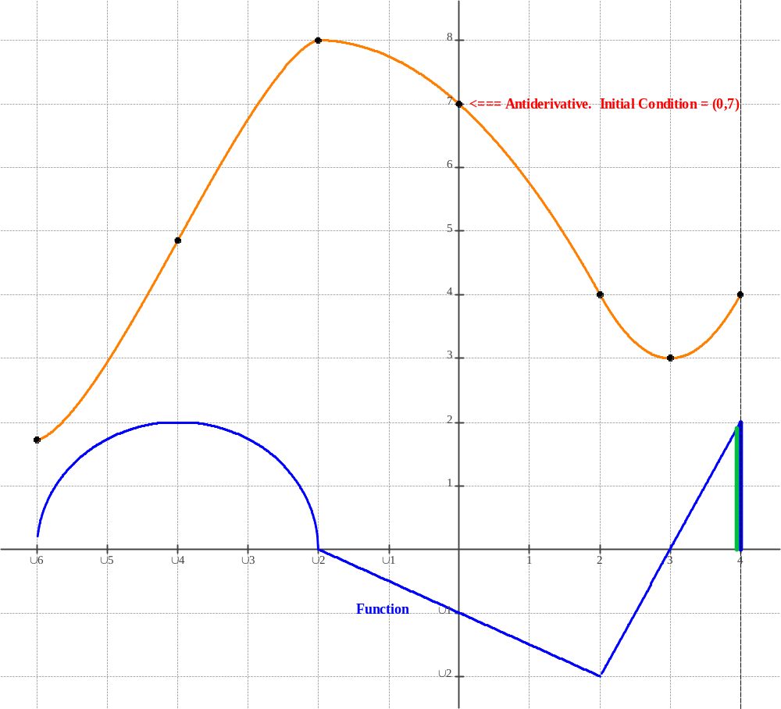
Graphing without Derivatives
Notes:
Winplot Concavity Demo 2
Demo 3 any function
Demo 4 linked windows’
Demo 5 Is the examples used in the slides above.

Slide 24
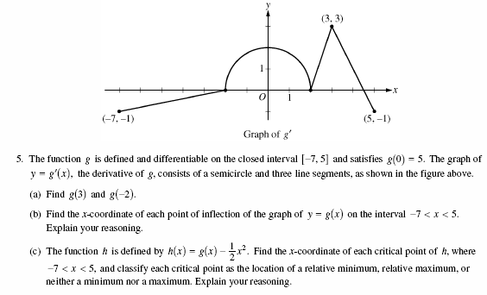
AP Calculus
Graph-stem Questions
Notes:
2010 Above
2011 AB 4
2010 AB 3 Amusement Park

Slide 25
Multiple-choice
2008 Part 1A:
9 – Absolute max/min
10 – Riemann sum
11 – Graph: Indentify graph of derivative
17 – FTC, POI
21 – Increasing (Motion)
27 – Slope Field
2008 Part 1B:
76 – Increasing
77 – Limits
84 – Relative Max/min
86 – Velocity table: identify position graph
2008: 10 questions = 12 points = 26.7%
2003: 9 questions = 10.8 points= 24%
Notes:
All questions with graphs in stem and/or answers
2008 10 questions = 12 points = 26.7%
2003 7, 10, 13, 21, 22, 77, 79, 85, 88, 9 questions = 11 points = 24.0%

Slide 26
Suggestions
Find and assign all you can of questions with a graph from you text, from past exams ….
Use released AP questions
Cumulative tests and assignments
Go further with each questions; find other features that can be determined from the graphs you have
Practice justifications; have students explain why the graphs have these features
Use at the end of the year to draw together disparate topics
Notes:
Be aware that your textbook does not group these ides and others in one section. They are spread thru your book therefore [bullet 1]
Better yet [bullet 2]
Extend and adapt the questions [bullet 3]
Stress writing from day 1, algebra 1 [bullet 4]
Use these to pull the disparate ideas together [bullet 5]

Slide 27
Information
E-mail: lnmcmullin@aol.com
The PowerPoint slides, the Winplot files, a detailed handout including a brief list of questions on this topic from Calculus by Rogawski and Cannon are here:
www.LinMcMullin.net
Click on AP Calculus
For more information on the textbook:
http://tinyurl.com/Rogawski

Slide 28
Here’s the Graph of the Derivative ….
Tell me About the Function
Lin McMullin
Calculus by Rogawski and Cannon
Webinar February 15, 2012

