Slide 1
The Writing Questions on the AP Calculus Exams
Presented by
Lin McMullin
‘Iolani School

Slide 2
Why worry about writing on the exam?
Students should be able to communicate mathematics and explain solutions to problems both verbally and in written sentences.
– from the GOALS of the AP Calculus Program

Slide 3
Why worry about writing on the exam?
Year | AB | BC
2007 | 9 | 9
2008 | 7 | 8
2009 | 7 | 3
2010 | 7 | 7
2011 | 7 | 6
2012 | 9 | 7
2013 | 9 | 7
2014 | 6 | 3
2015 | 8 | 6
“Writing” points on the operational exams free-response questions

Slide 4
Writing Prompts
Justify your answer
Explain your reasoning
Why?
Give a reason for your answer
Explain the meaning of a definite integral in the context of the problem
Explain the meaning of a derivative in the context of the problem

Slide 5
What to do? . . . the short answer
Determine which theorem or definition applies
State (show) that your problem meets the hypotheses of the theorem or definition – BE SPECIFIC!

Slide 6
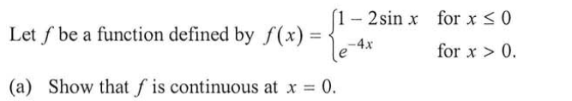
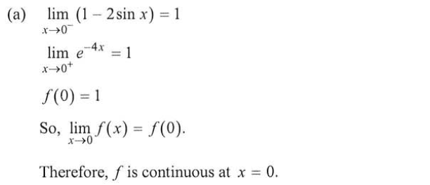
Continuity
2007 AB 6

Slide 7
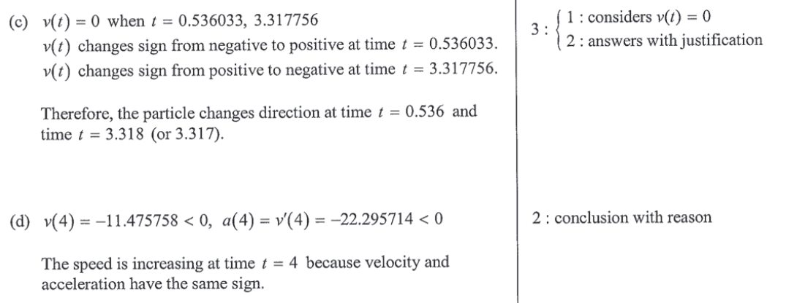
Justify your answer
2013 AB 2 – Increasing/decreasing and Speed

Slide 8
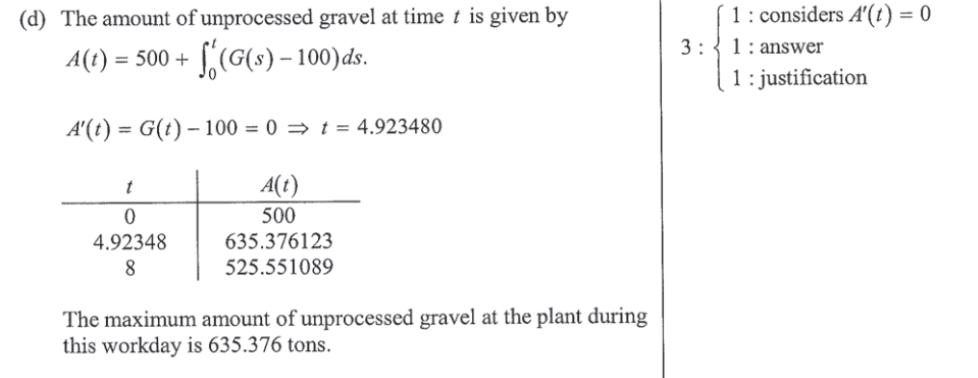
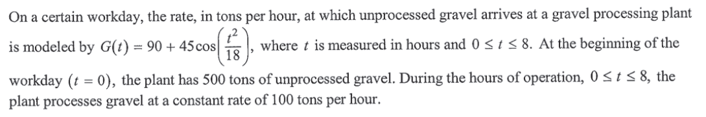
Justify your answer. Extreme Values
2013 AB 1 / BC 1 – The Candidates’ Test

Slide 9
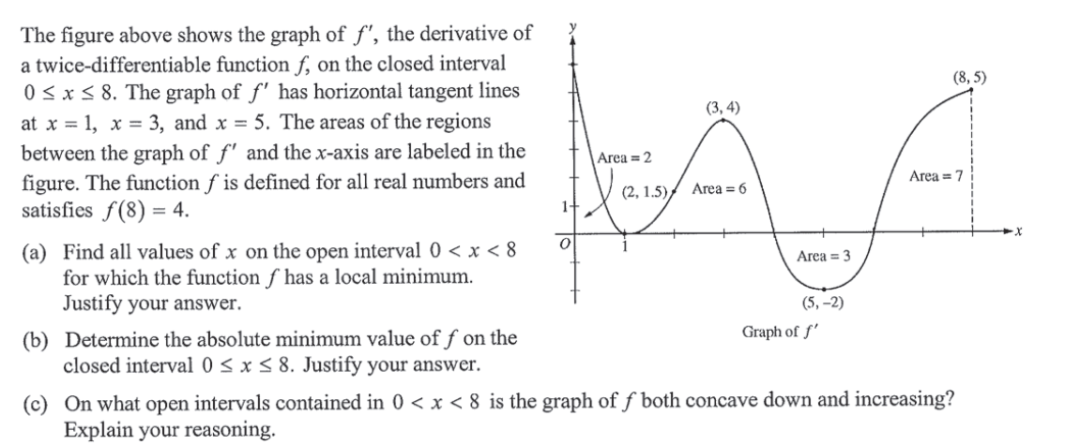
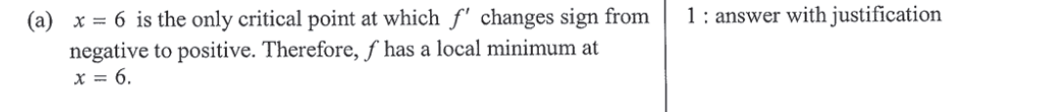
Justify your answer
2013 AB4 / BC4 – The First Derivative Test

Slide 10
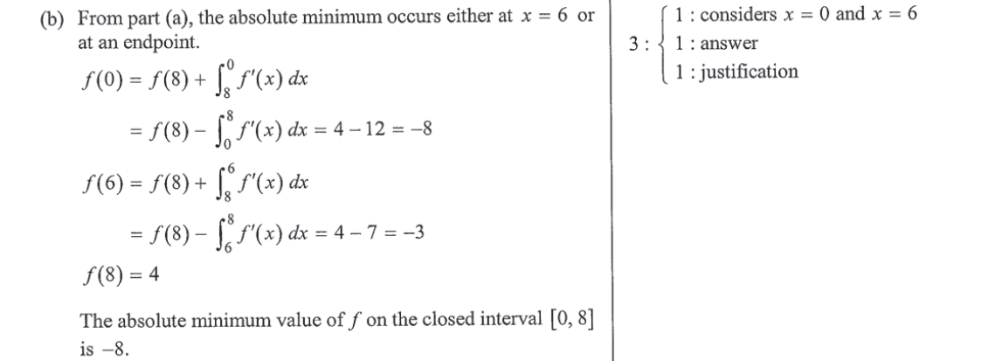

Justify your answer
2013 AB4 / BC 4 – The Candidates’ Test

Slide 11
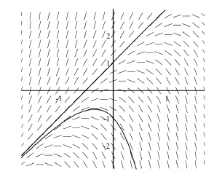

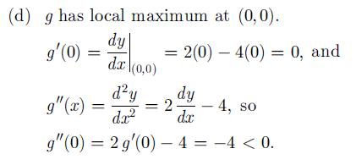

Justify your answer
2002 BC 5 – The Second Derivative Test

Slide 12
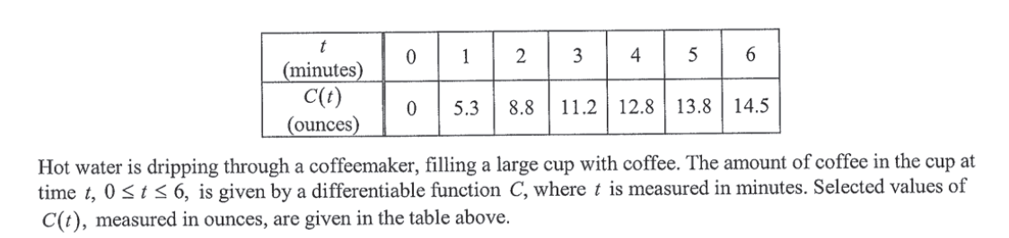
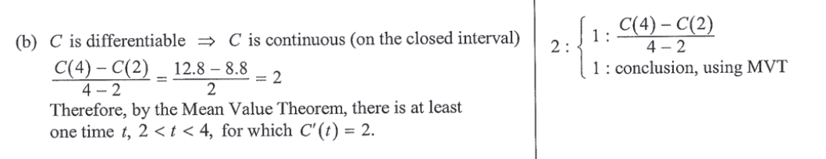
Justify your answer
2013 AB3 / BC 3 – The Mean Value Theorem

Slide 13
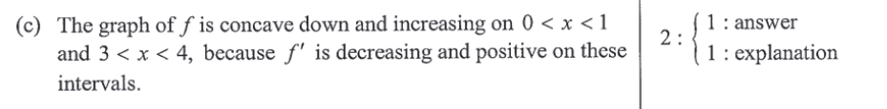
Explain your reasoning
2013 AB4 / BC 4 – Concavity & Increasing/decreasing

Slide 14
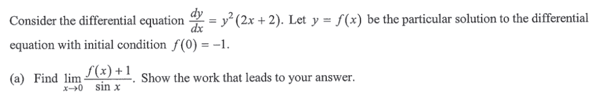
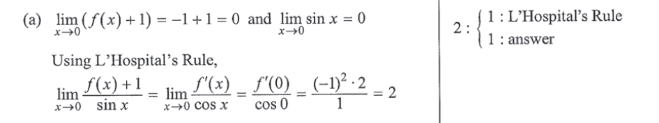
Show the work …
2013 BC 5 – L’Hôpital’s Rule

Slide 15
Explain the meaning of
. . . a definite integral
Include three things in the context of the problem:
What the integral gives (amount, average value, change in position, etc.)
Units
What the limits of integration mean.

Slide 16
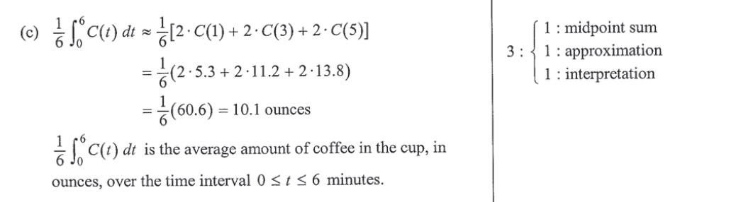
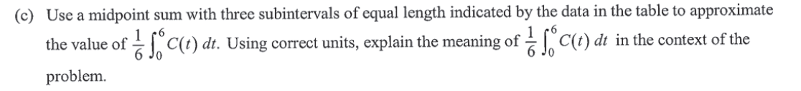
Explain the meaning of a definite integral
2013 AB3 / BC 3

Slide 17
Explain the meaning of
. . . a definite integral
Hint: Use the Fundamental Theorem of Calculus

Slide 18
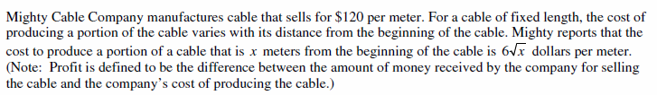

Explain the meaning of a definite integral
2009 AB 3 Might Cable Company

Slide 19
Explain the meaning of
. . . a derivative
Include three things in the context of the problem:
What the derivative gives (rate of change, velocity, slope, etc.)
Units
Discussion of the argument .

Slide 20
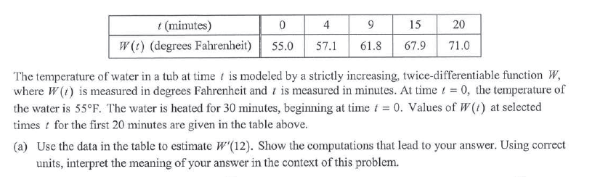
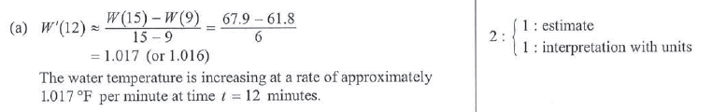
Explain the meaning of a derivative
2012 AB1 / BC 1

Slide 21
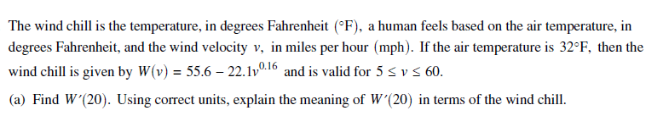
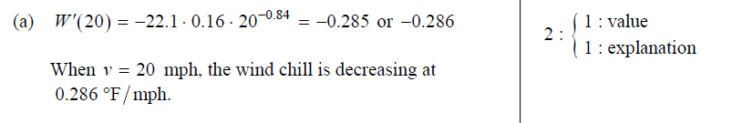
Explain the meaning of a derivative
2007 Form B AB3

Slide 22
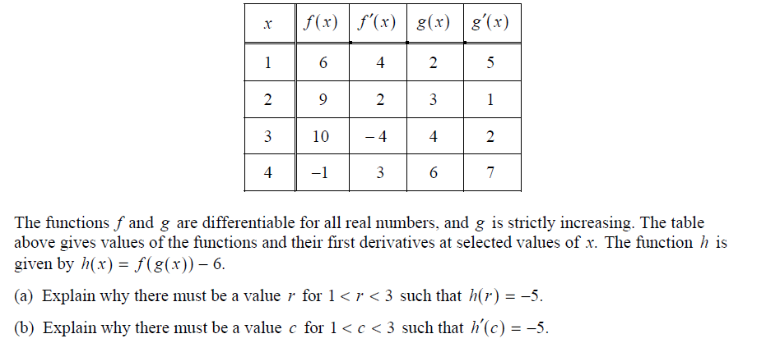
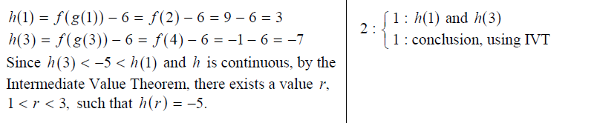
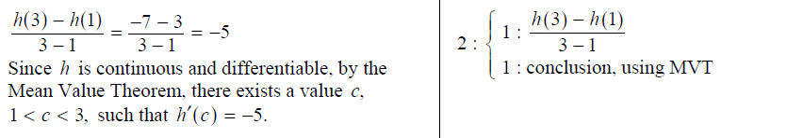
Other Theorems
2007 AB 3 – IVT, MVT

Slide 23
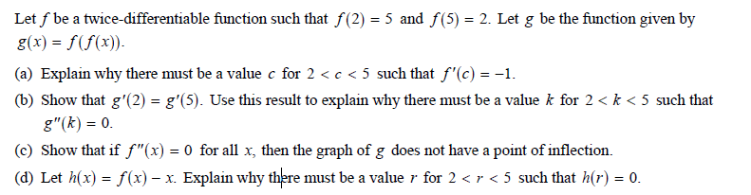

Theorem Questions
2007 AB 6 – F0rm B

Slide 24
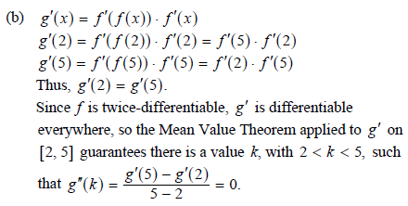
Theorem Questions
2007 AB 6 – F0rm B

Slide 25
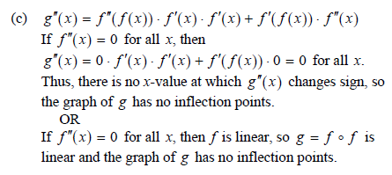
Theorem Questions
2007 AB 6 – F0rm B

Slide 26
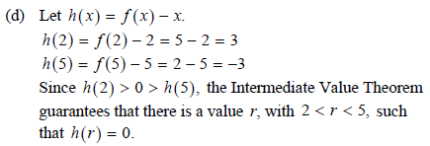
Theorem Questions
2007 AB 6 – F0rm B

Slide 27

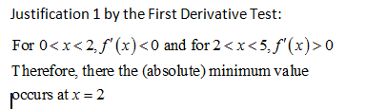
Quiz
Let for all . Find the location of the minimum value of . Justify your answer three different ways.

Slide 28
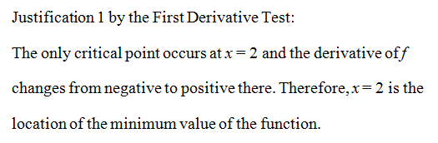
Quiz
Let for all . Find the location of the minimum value of . Justify your answer three different ways.

Slide 29
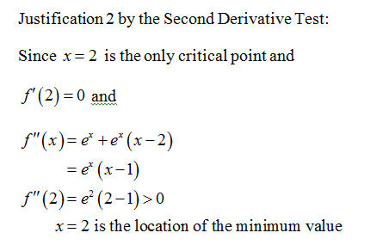
Quiz
Let for all . Find the location of the minimum value of . Justify your answer three different ways.

Slide 30
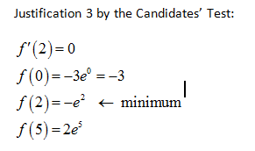
Quiz
Let for all . Find the location of the minimum value of . Justify your answer three different ways.

Slide 31
The Writing Questions on the AP Calculus Exams
Presented by
Lin McMullin
‘Iolani School

Slide 32
LnMcMullin@aol.com
http://www.linmcmullin.net
http://teachingcalculus.com

