Slide 1
AP Calculus
The Rule of
4

Slide 2
AP Calculus
Philosophy
The courses emphasize a multi-representational approach to calculus, with concepts, results, and problems being expressed
  geometrically,
  numerically,
  analytically, and
  verbally.
  The connections among these representations also are important.

Slide 3
AP Calculus
Goals
Work with functions represented in a variety of ways: graphical, numerical, analytical, or verbal. They should understand the connections among these representations.

Slide 4
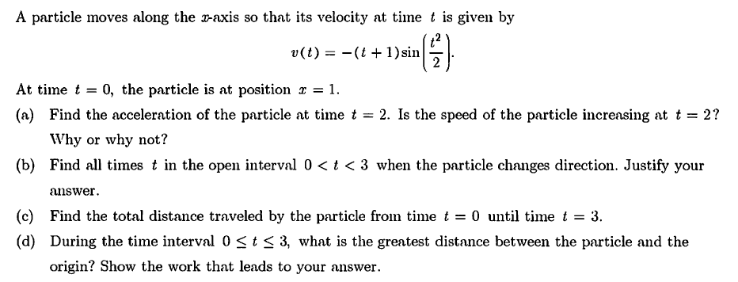
Equation (Analytic) Stem

Slide 5
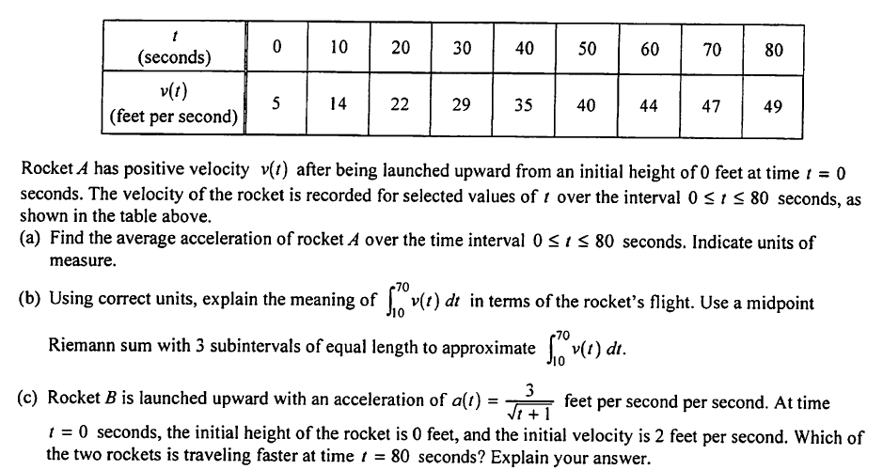
Number Stem

Slide 6
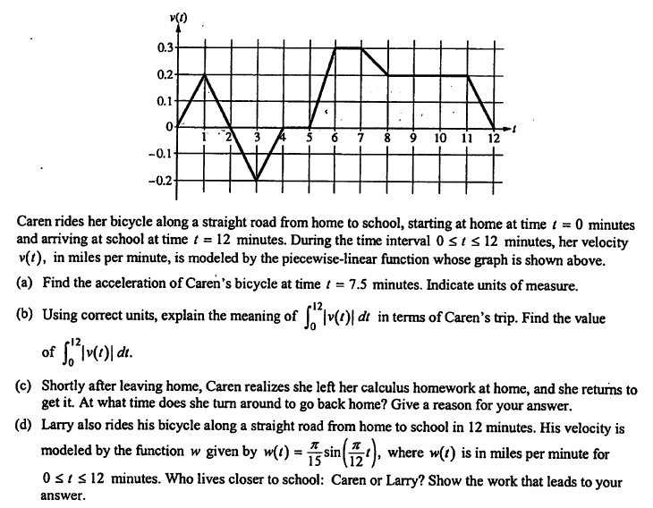
Graph Stem

Slide 7
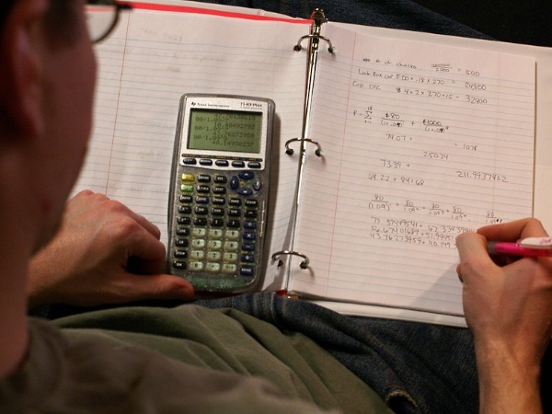
Technology

