Slide 1
Teaching Limits so that Students will Understand Limits
Presented by
Lin McMullin
National Math and Science Initiative

Slide 2
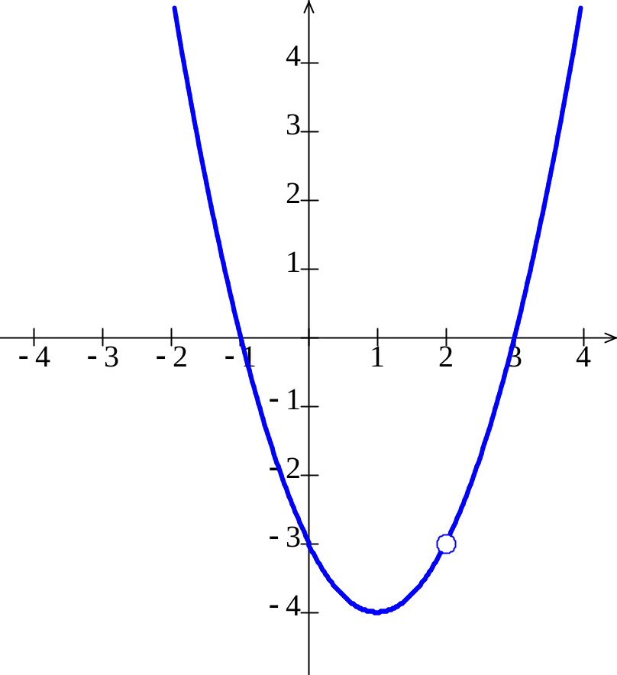
Continuity
What happens at x = 2?
What is f(2)?
What happens near x = 2?
f(x) is near −3
What happens as x approaches 2?
f(x) approaches −3

Slide 3
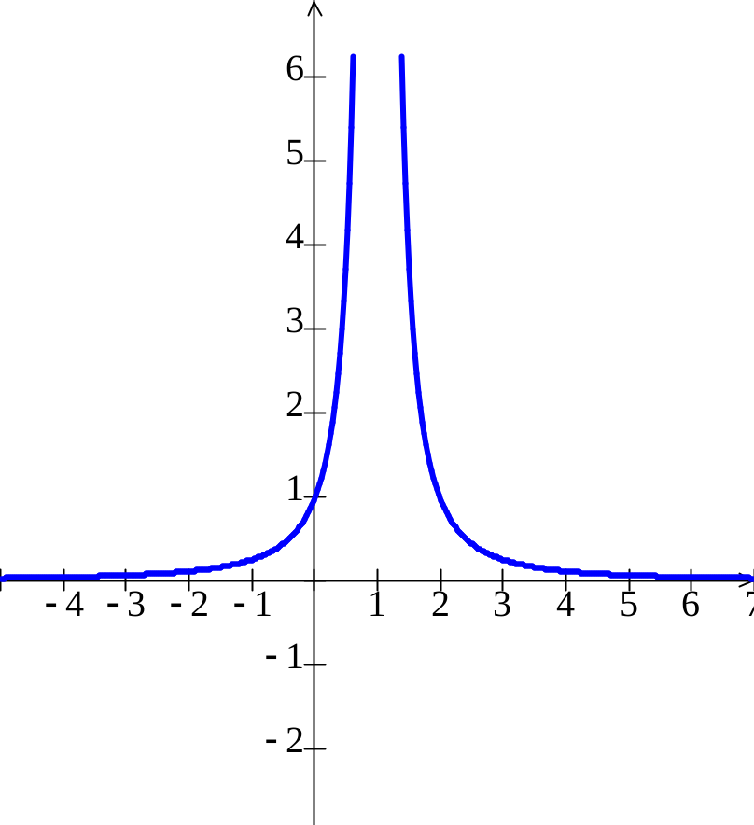
Asymptotes
What happens at x = 1?
What happens near x = 1?
As x approaches 1, g increases without bound, or g approaches infinity.
As x increases without bound, g approaches 0.
As x approaches infinity g approaches 0.

Slide 4
Asymptotes
x | x-1 | 1/(x-1)^2
0.9 | -0.1 | 100.00
0.91 | -0.09 | 123.46
0.92 | -0.08 | 156.25
0.93 | -0.07 | 204.08
0.94 | -0.06 | 277.78
0.95 | -0.05 | 400.00
0.96 | -0.04 | 625.00
0.97 | -0.03 | 1,111.11
0.98 | -0.02 | 2,500.00
0.99 | -0.01 | 10,000.00
1 | 0 | Undefined
1.01 | 0.01 | 10,000.00
1.02 | 0.02 | 2,500.00
1.03 | 0.03 | 1,111.11
1.04 | 0.04 | 625.00
1.05 | 0.05 | 400.00
1.06 | 0.06 | 277.78
1.07 | 0.07 | 204.08
1.08 | 0.08 | 156.25
1.09 | 0.09 | 123.46
1.10 | 0.1 | 100.00

Slide 5
Asymptotes
x | x-1 | 1/(x-1)^2
1 | 0 | Undefinned
2 | 1 | 1
5 | 4 | 0.25
10 | 9 | 0.01234567901234570
50 | 49 | 0.00041649312786339
100 | 99 | 0.00010203040506071
500 | 499 | 0.00000401604812832
1,000 | 999 | 0.00000100200300401
10,000 | 9999 | 0.00000001000200030
100,000 | 99999 | 0.00000000010000200
1,000,000 | 999999 | 0.00000000000100000
10,000,000 | 9999999 | 0.00000000000001000
100,000,000 | 99999999 | 0.00000000000000010

Slide 6
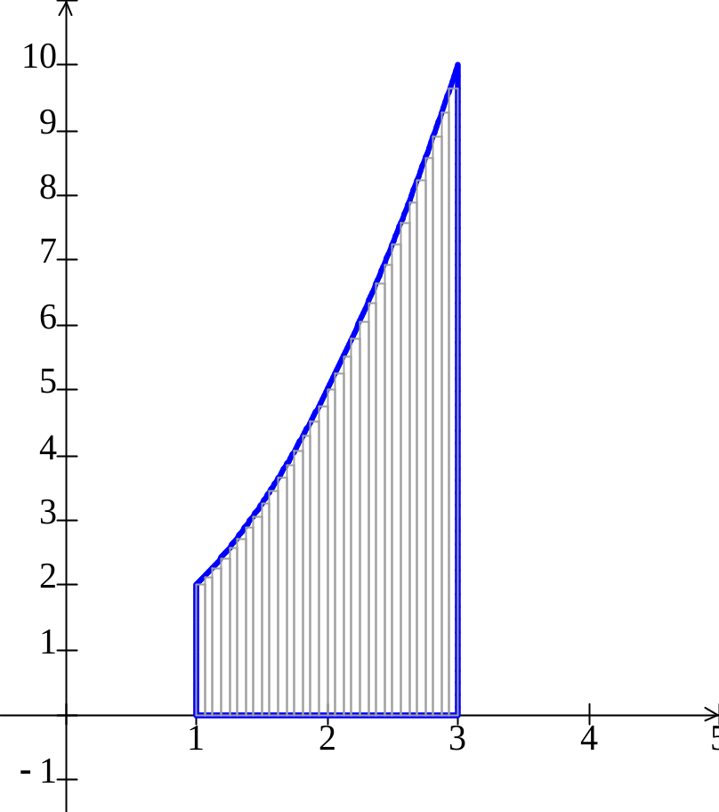
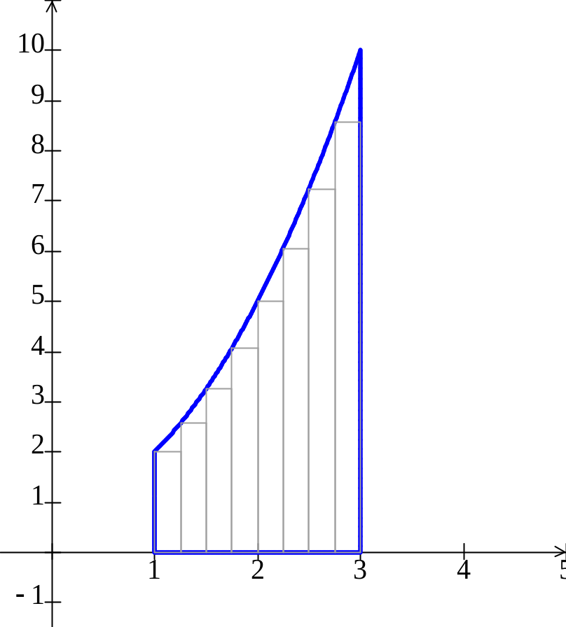
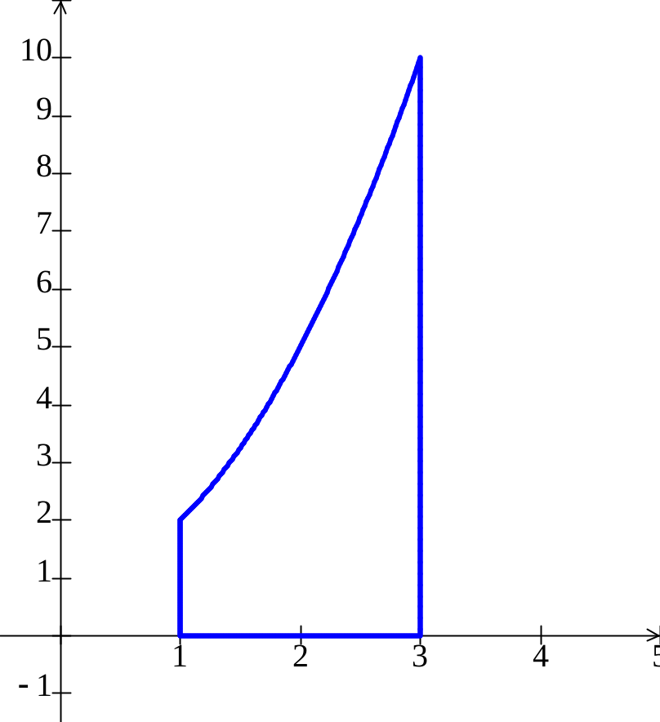
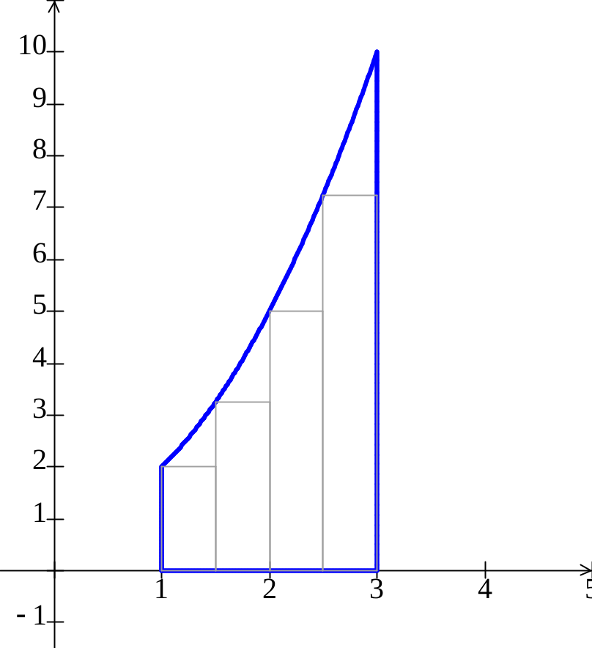
The Area Problem
What is the area of the outlined region?
As the number of rectangles increases with out bound, the area of the
rectangles approaches the area of the region.

Slide 7
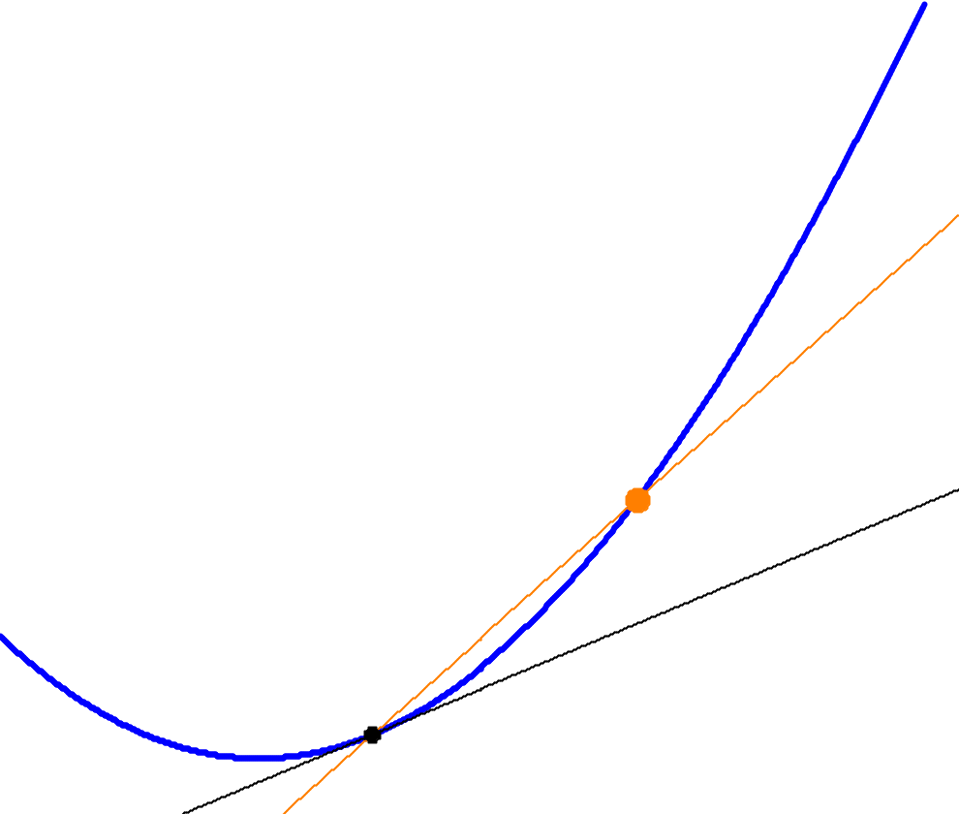
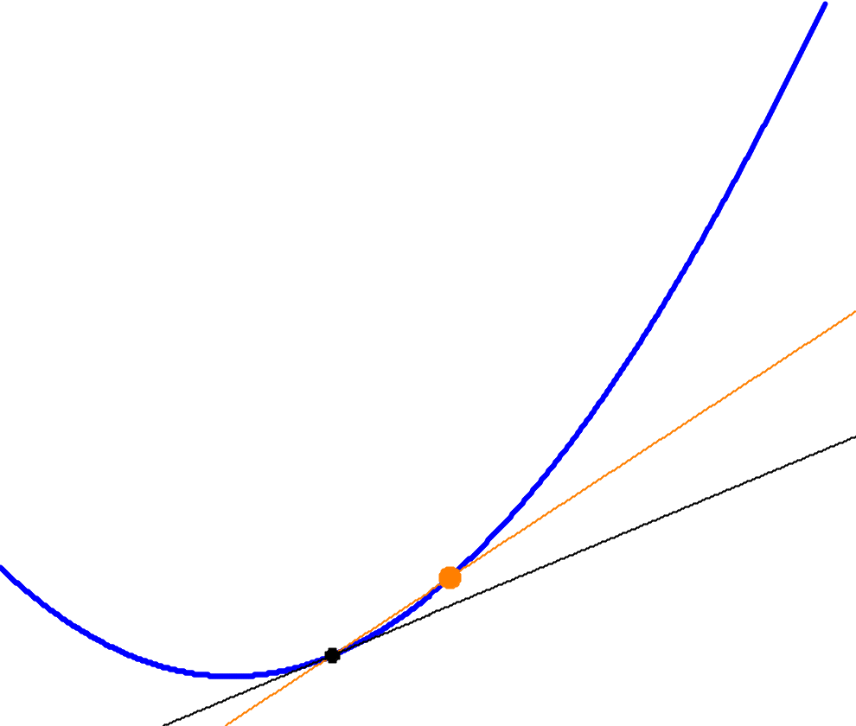
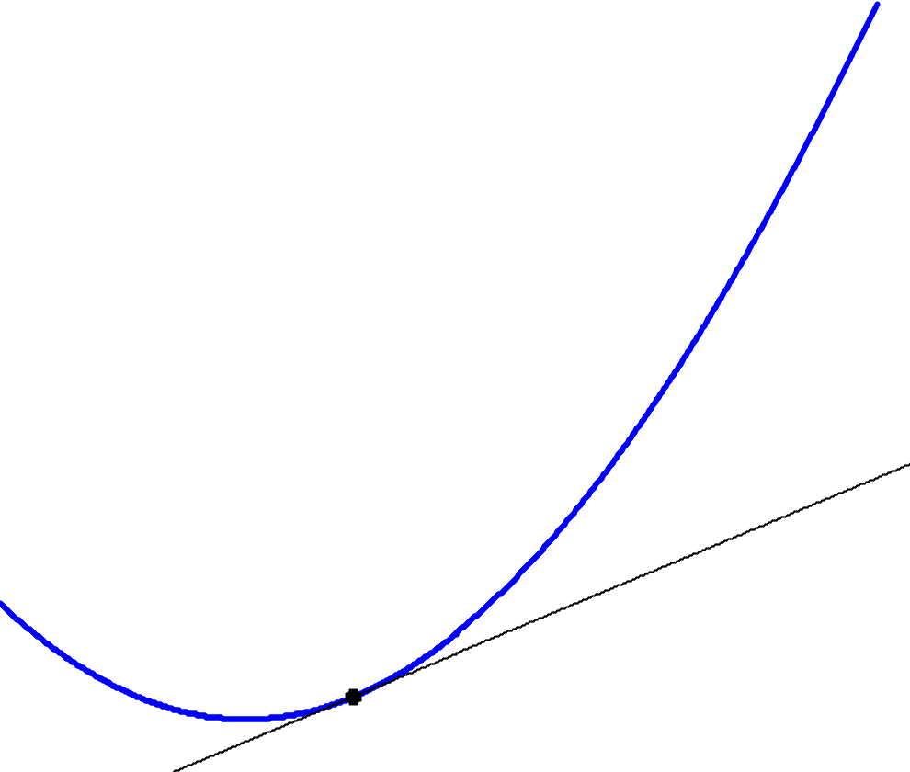
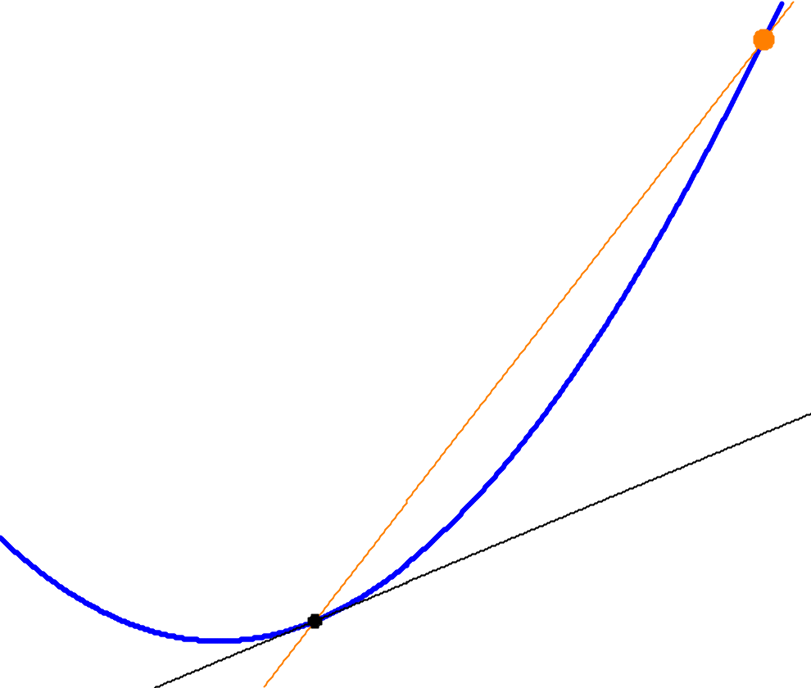
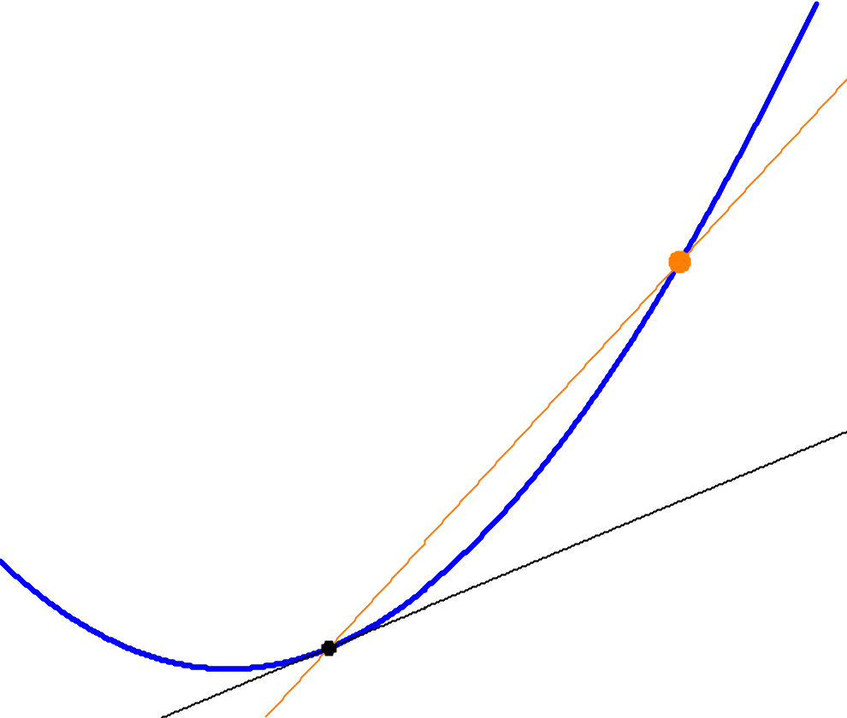
The Tangent Line Problem
What is the slope of the black line?
As the red point approaches the black point, the red secant line approaches the black tangent line, and
The slope of the secant line approaches the slope of the tangent line.

Slide 8
As x approaches 1, (5 – 2x) approaches ?
0.90 | 3.20
0.91 | 3.18
0.92 | 3.16
0.93 | 3.14
0.94 | 3.12
0.95 | 3.10
0.96 | 3.08
0.97 | 3.06
0.98 | 3.04
0.99 | 3.02
1.00 | 3.00
1.01 | 2.98
1.02 | 2.96
1.03 | 2.94
1.04 | 2.92
1.05 | 2.90
1.06 | 2.88
1.07 | 2.86
1.08 | 2.84
1.09 | 2.82
x within 0.08 units of 1
x within 0.04 units of 1
f(x) within 0.08 units of 3
f(x) within 0.16 units of 3

Slide 10
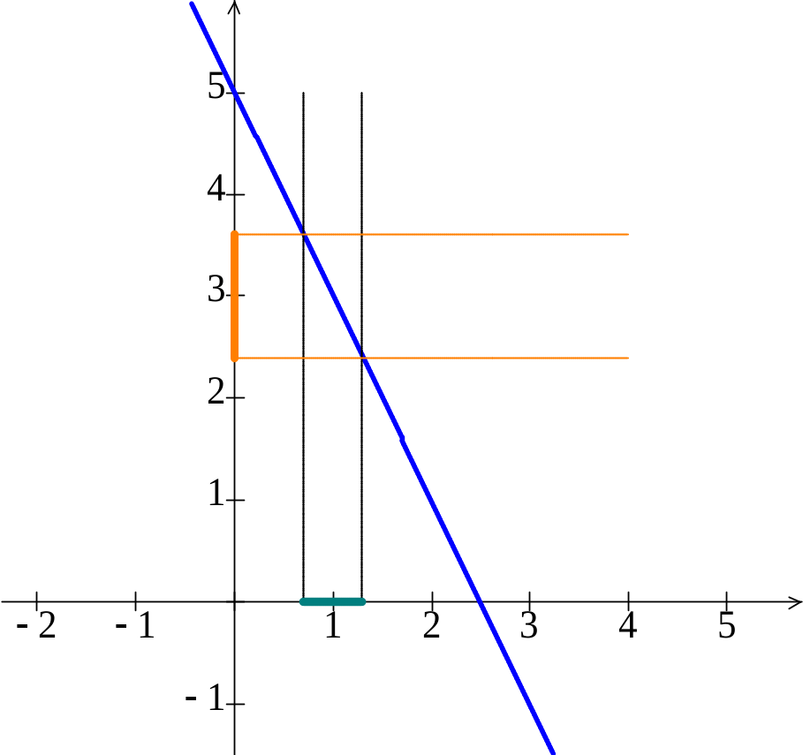
Graph

Slide 11
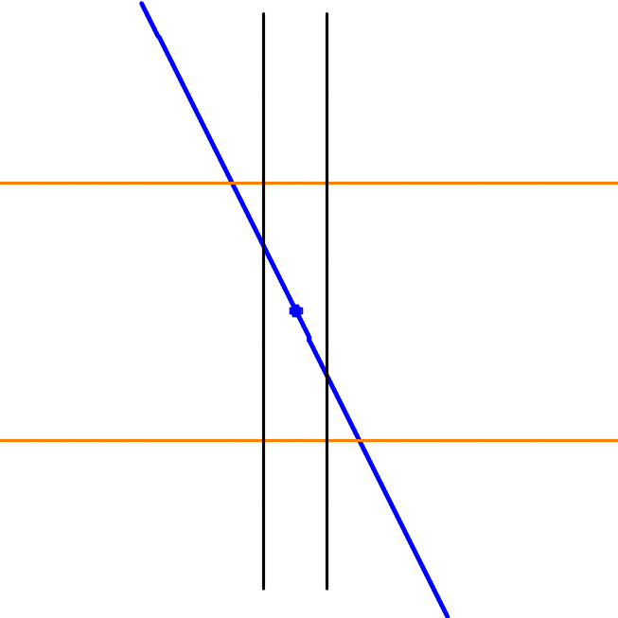
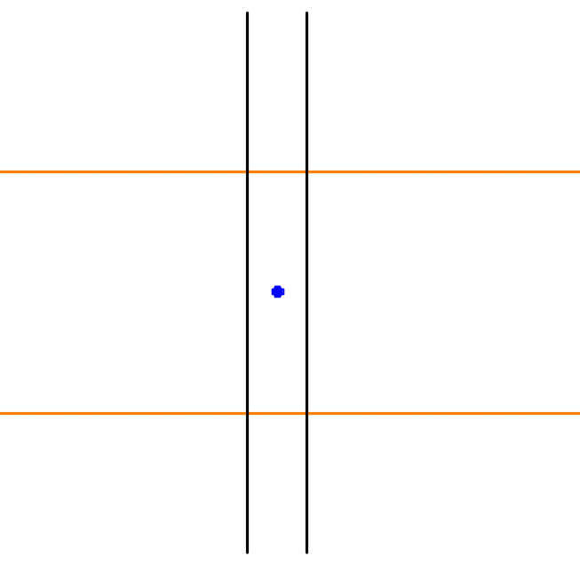
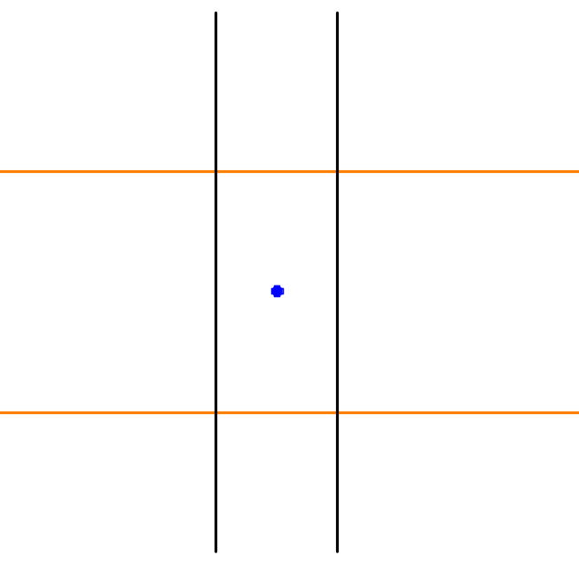
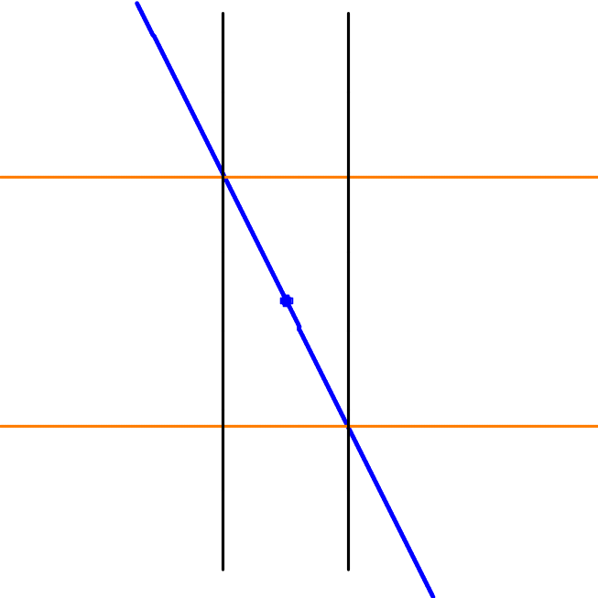
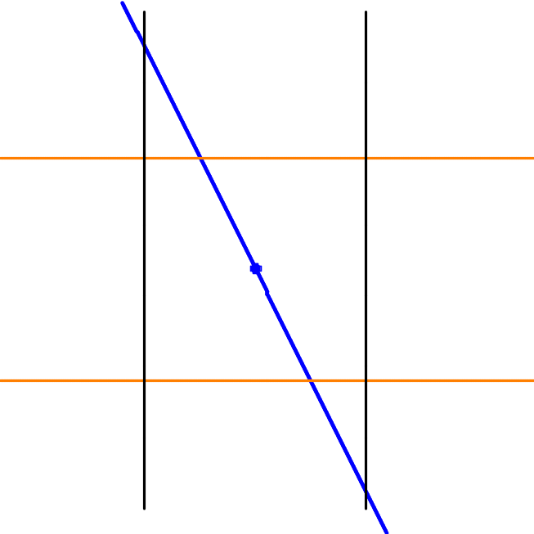
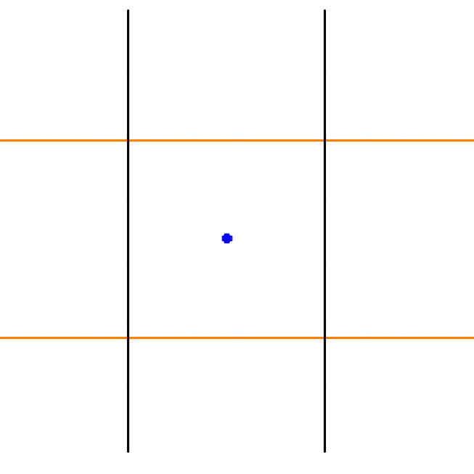

Slide 12
The Definition of Limit at a Point
When the values successively attributed to a variable approach indefinitely to a fixed value, in a manner so as to end by differing from it as little as one wishes, this last is called the limit of all the others.
Augustin-Louis Cauchy (1789 – 1857)

Slide 13
The Definition of Limit at a Point
Karl Weierstrass (1815 – 1897)

Slide 14
The Definition of Limit at a Point
Karl Weierstrass (1815 – 1897)

Slide 15
Footnote:
The Definition of Limit at a Point

Slide 16
Footnote:
The Definition of Limit at a Point

Slide 17
0.90 | 3.20
0.91 | 3.18
0.92 | 3.16
0.93 | 3.14
0.94 | 3.12
0.95 | 3.10
0.96 | 3.08
0.97 | 3.06
0.98 | 3.04
0.99 | 3.02
1.00 | 3.00
1.01 | 2.98
1.02 | 2.96
1.03 | 2.94
1.04 | 2.92
1.05 | 2.90
1.06 | 2.88
1.07 | 2.86
1.08 | 2.84
1.09 | 2.82
x within 0.08 units of 1
x within 0.04 units of 1
f(x) within 0.08 units of 3
f(x) within 0.16 units of 3

Slide 22
Graph

Slide 23
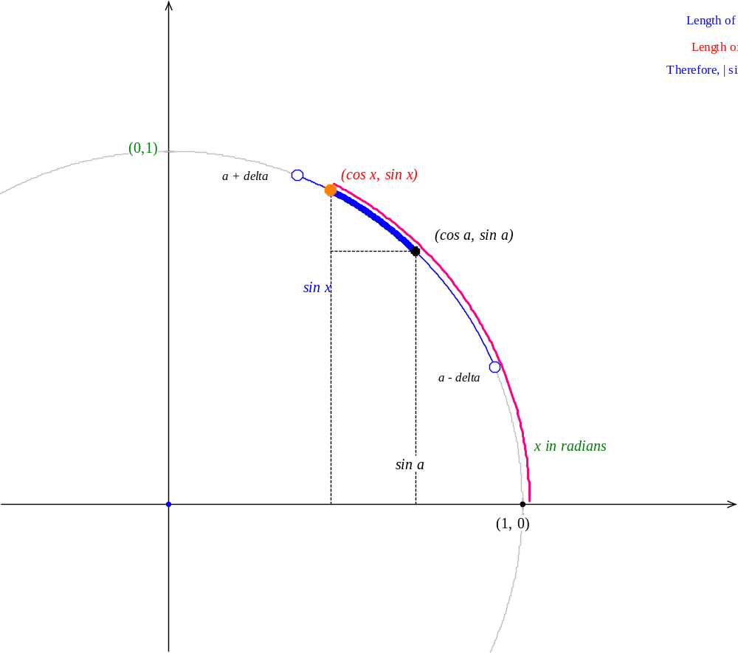
Graph

Slide 24
One-sided Limits

Slide 25
Limits Equal to Infinity

Slide 26
Limit as x Approaches Infinity

Slide 27
Limit Theorems
Almost all limit are actually found by substituting the values into the expression, simplifying, and coming up with a number, the limit.
The theorems on limits of sums, products, powers, etc. justify the substituting.
Those that don’t simplify can often be found with more advanced theorems such as L'Hôpital's Rule

Slide 28
The Area Problem

Slide 29
The Area Problem

Slide 30
The Area Problem

Slide 31
The Tangent Line Problem

Slide 32
The Tangent Line Problem

Slide 33
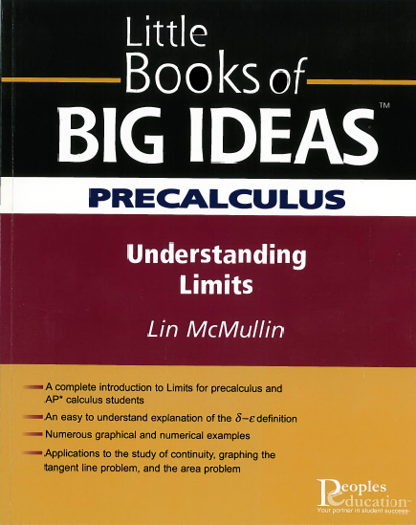

Slide 34
Lin McMullin
National Math and Science Initiative
325 North St. Paul St.
Dallas, Texas 75201
214 665 2500
lmcmullin@NationalMathAndScience.org
www.LinMcMullin.net Click: AP Calculus

Slide 35

Lin McMullin
lmcmullin@NationalMathAndScience.org
www.LinMcMullin.net Click: AP Calculus

Slide 36
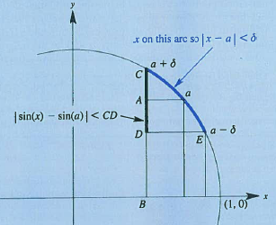

Slide 38
The Tangent Line Problem

